Slide 1
Learning modules of the CAPTIVATE project
The main outputs
of the CAPTIVATE project, 2024.10.21.
John von Neumann University

Slide 2
CAPTIVATE – PR 4: Learning module
Methodological training and writing modular teaching materials related to organic farming
Characteristics:
Developing methodology and writing teaching materials
CAP-specific, flexible teaching
Format: open / online / digital education - Open Education Resource (OER)

Slide 3
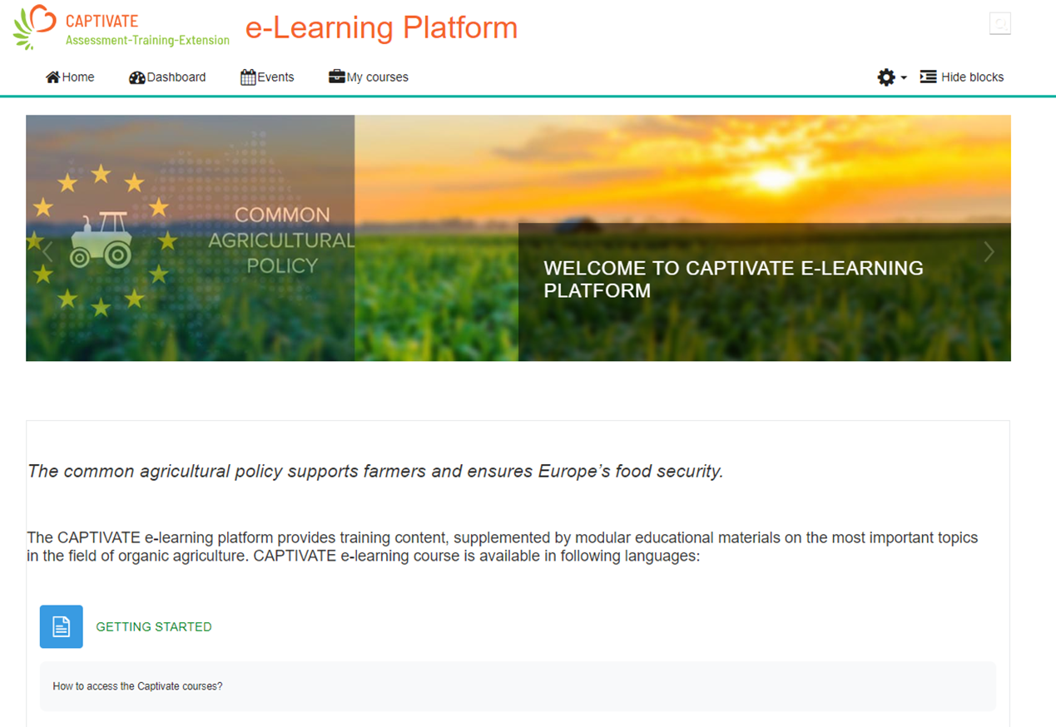
Contact: cap-tivate.eu

Slide 4
Training modules
Module 1: EU’s New Relevant Strategies
Strategies, action plans, New CAP rules and requirements:
Conditionality
Environmental measures
Related rural development programmes

Slide 5
Topics of Module 1
European Green Deal
Farm to Fork strategy
New Common Agricultural Policy (CAP)
Biodiversity Strategy
Soil Protection Strategy
Ecological Action Plan
Quiz questions linked to the materials

Slide 6
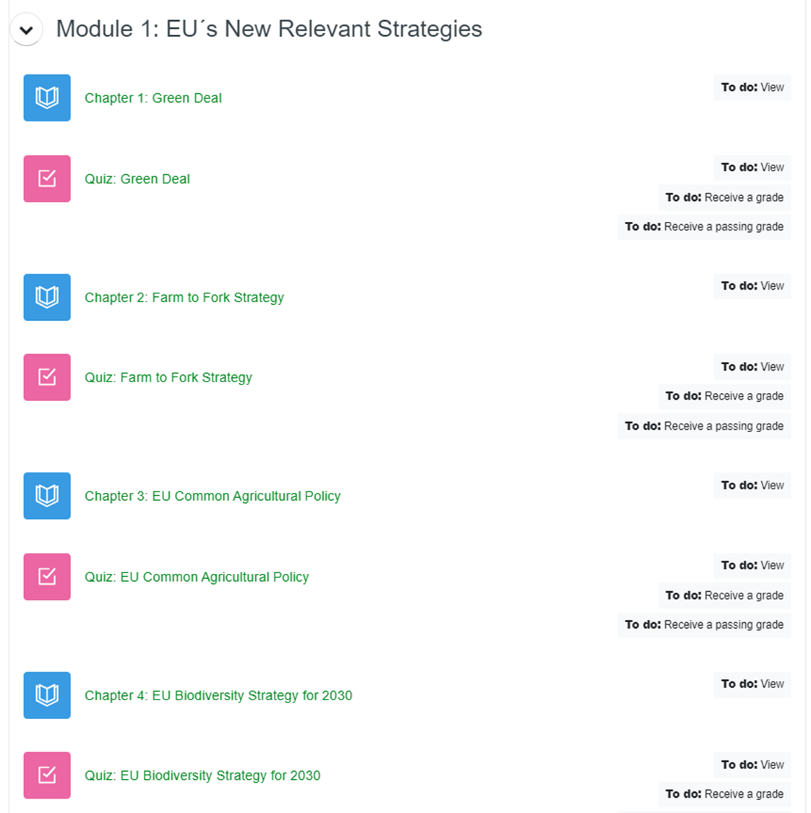

Slide 7
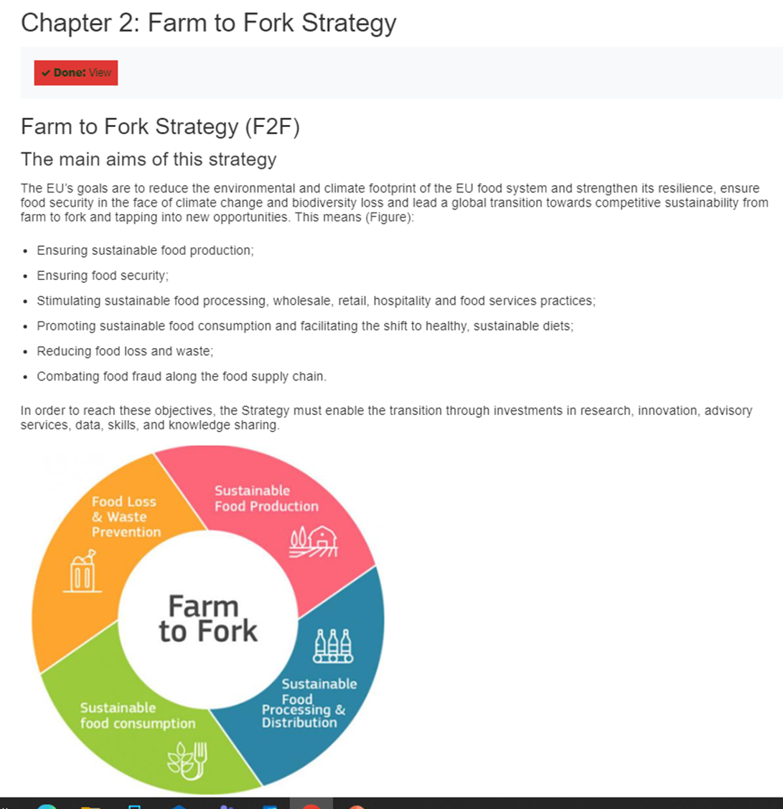

Slide 8
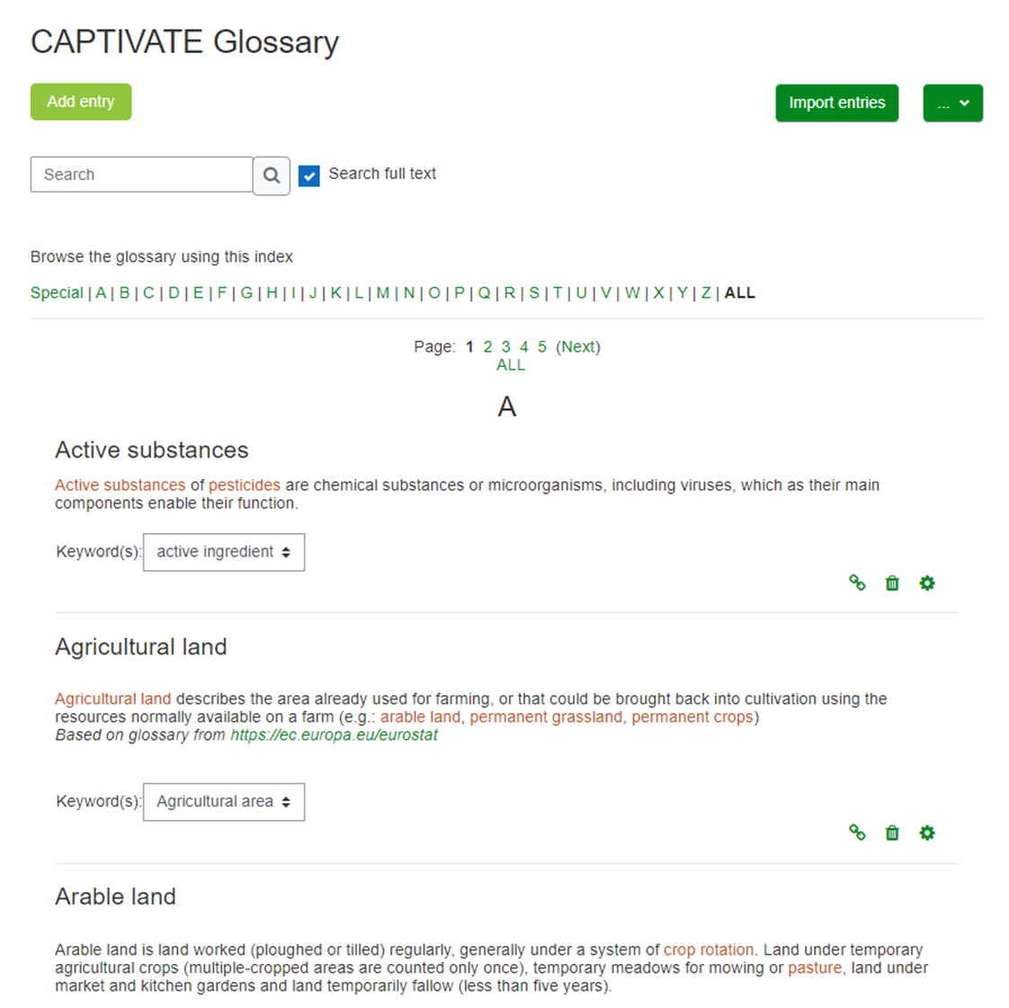
Glossary

Slide 9
Module 2:
Sustainability and agriculture: guidelines and practices for everyday farming practice
Good organic practices identified in the project, in line with CAP requirements
Topics covered: e.g. soil, agroecology, plant protection, etc.
Module 3: Using the project's digital learning platform (Moodle)

Slide 10
Topics of Module 2
The principles of sustainability
The practical framework for sustainable agriculture: agroecology
Sustainable use of soils
Sustainable practices: crop protection
Animal welfare and sustainability
Farm diversification

Slide 11
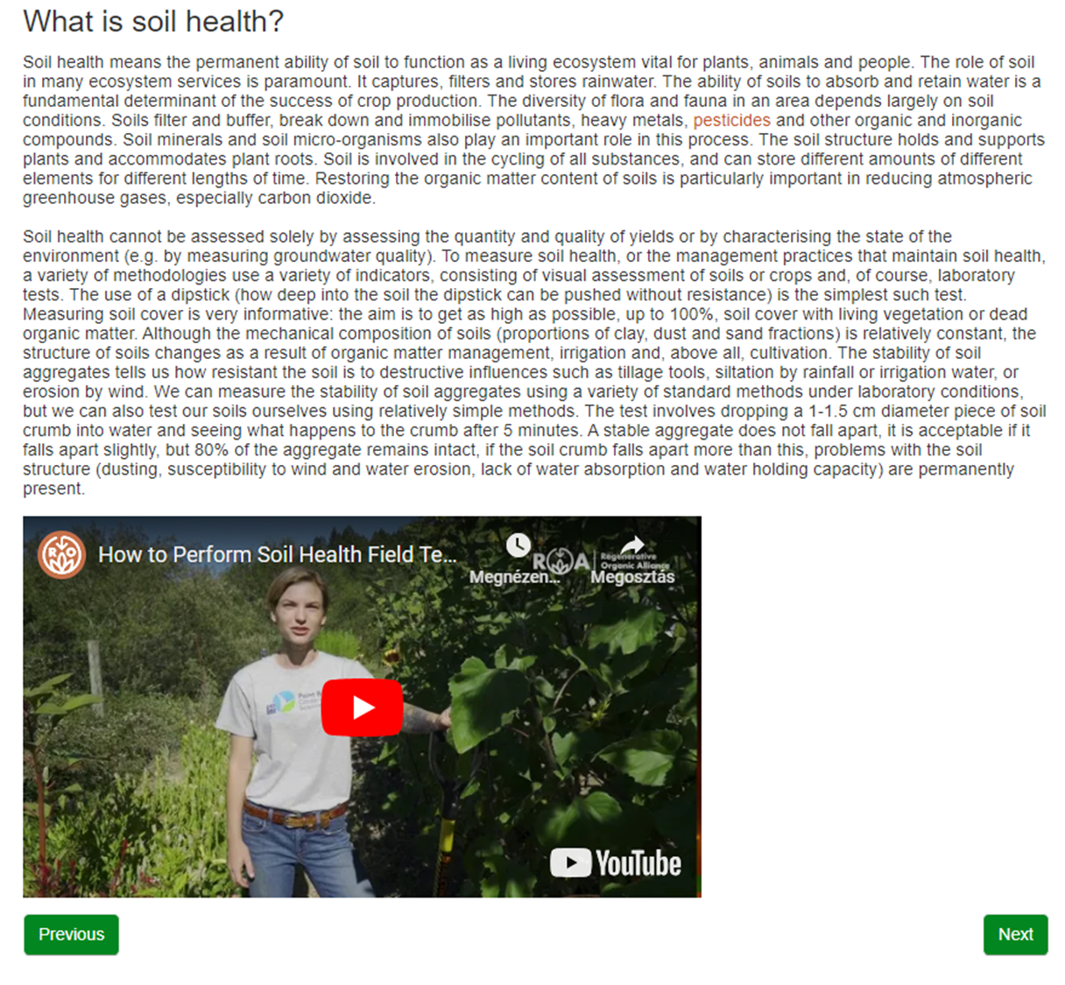

Slide 12
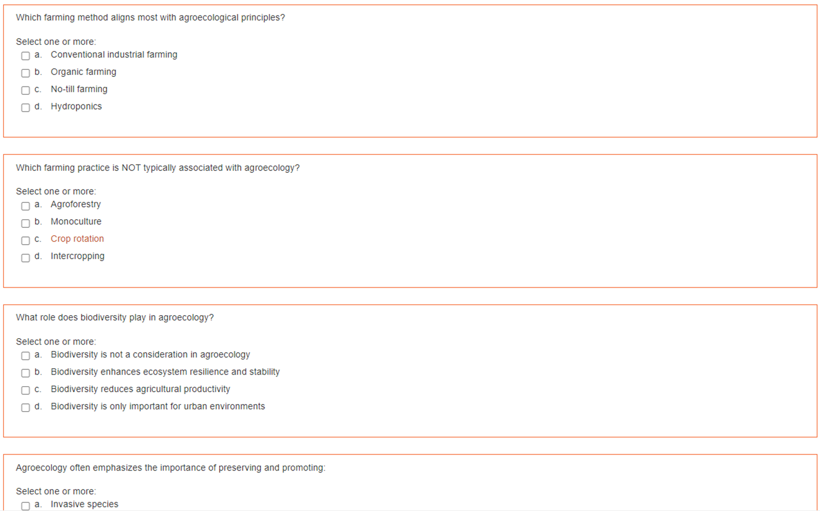

Slide 13
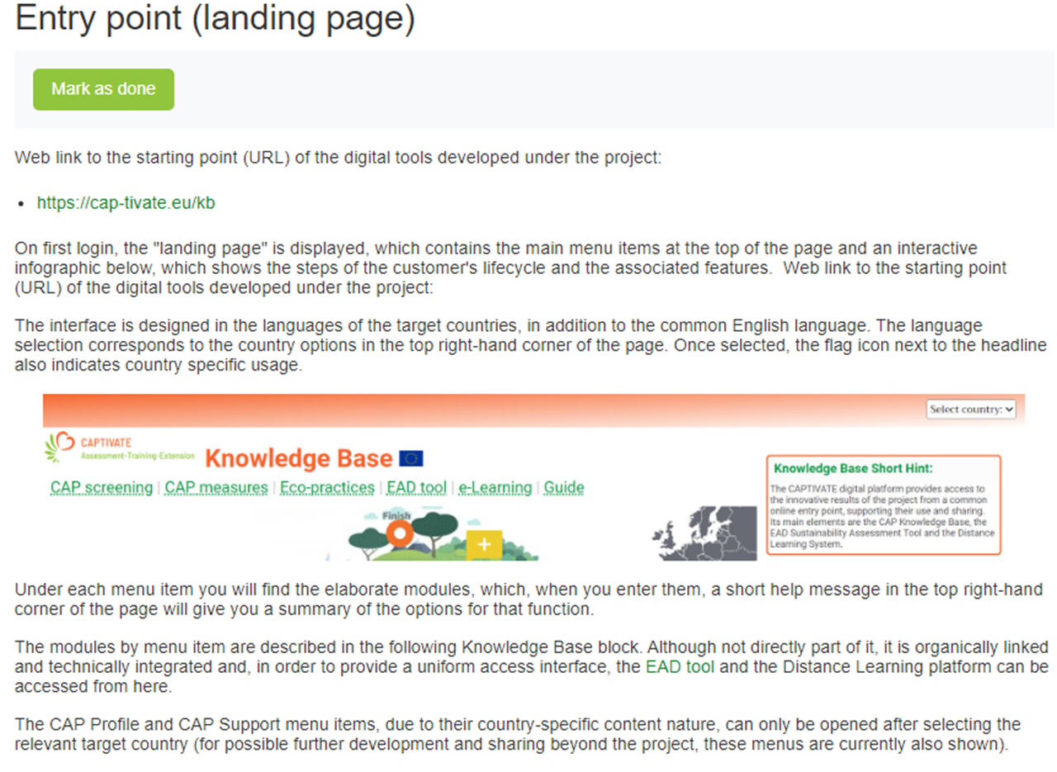
Module 3
CAPTIVATE digital
platform
„User Guide”

Slide 14
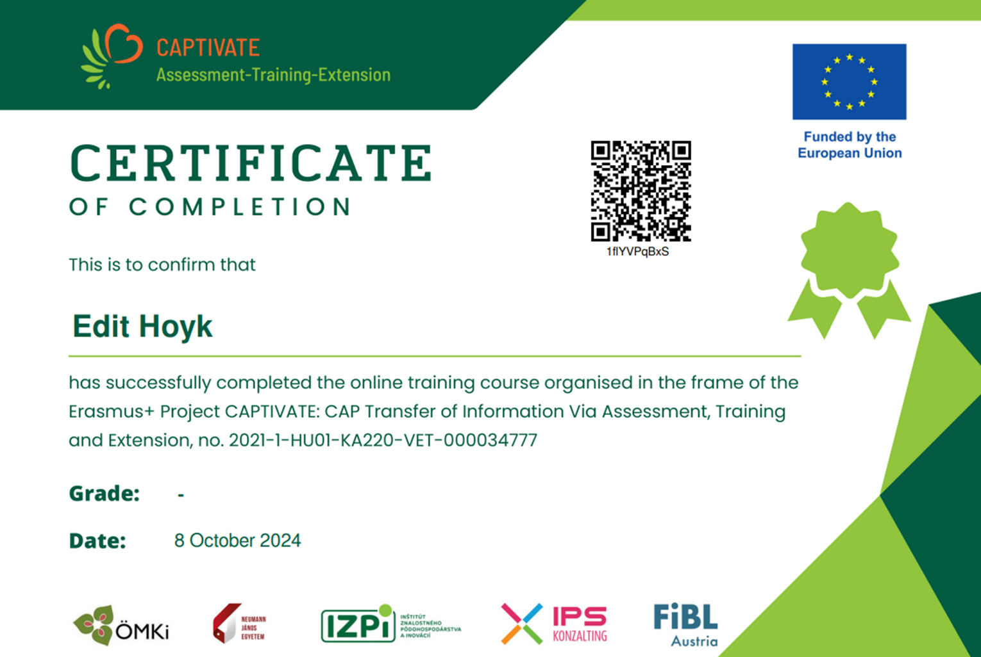

Slide 15
Thank you for your attention!

