Slide 1
CAPTIVATE Knowledge Platform: connecting CAP measures with eco-practices
CAP Transfer of Information
Via Assessment, Training & Extension
Laszlo Gabor Papocsi
CAPTIVATE project closing online event, 21th October 2024

Slide 2
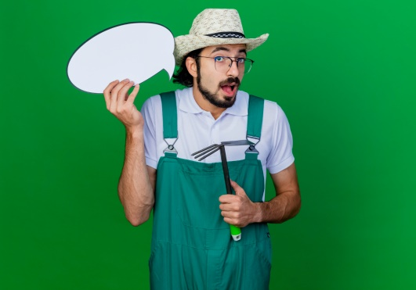
Challenge and objective
There are numerous information resources available at the national and EU levels, which publish information about the available support (subsidy, grant) opportunities and connected
Their content is not represented in a user friendly way, to be easily searchable and understandable for farmers. Most of the regulations are rather lengthy, consisting of many pages of legal language, while the relevant content - matching the everyday farming context - is usually not highlighted and explained well enough.
The other major problem is that although the regulations and rules very often require the application of specific farming practices, they contain only minimal information about them, so that interested parties have to research them individually elsewhere, if there is a credible, professionally sound source available at all.
Our project aims to fill these holes, to access information from both angles of finding financial support and implementing good agro-techniques for more sustainable farming.

Slide 3
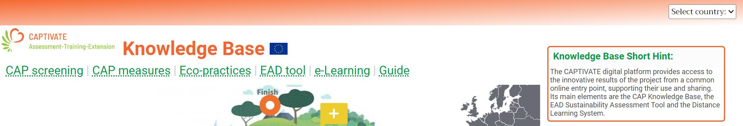
Landing page
The modules of the CAPTIVATE digital platform can be accessed from a common entrypoint, which basically functions as a "landing page" to attract external and first-time visitors.
Web link to the starting point (URL) of the digital tools developed under the project: https://cap-tivate.eu/kb
The "landing page" contains the main menu items at the top of the page and an interactive infographic below, which shows the steps of the customer's lifecycle and the associated features.
The interface is designed in the languages of the target countries, in addition to the common English language. The language selection corresponds to the country options in the top right-hand corner of the page
The CAP Profile and CAP Support menu items, due to their country-specific content nature, can only be opened after selecting the relevant target country (for possible further development and sharing beyond the project, these menus are currently also shown).

Slide 4
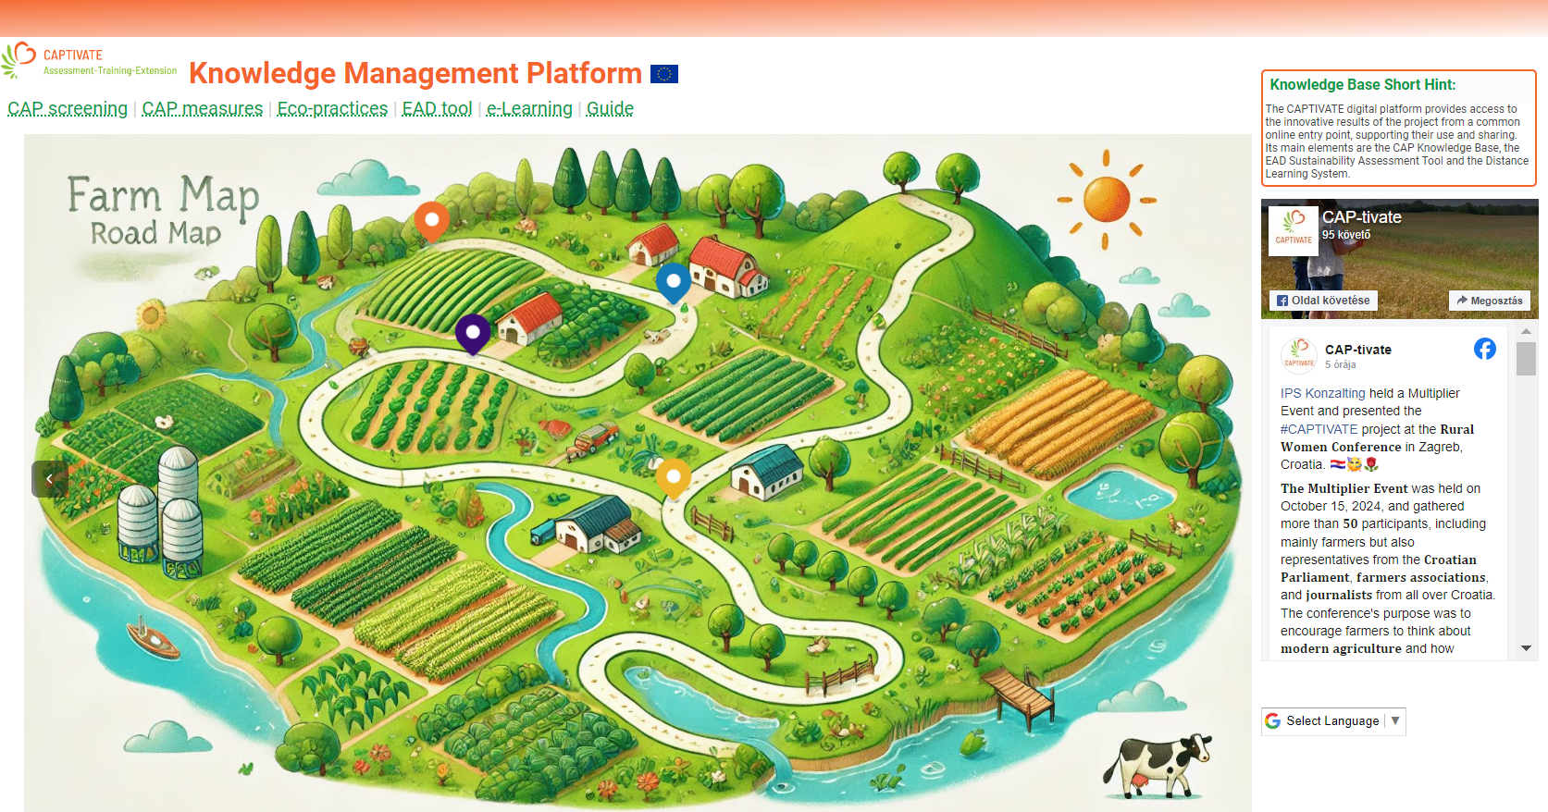
Landing page

Slide 5
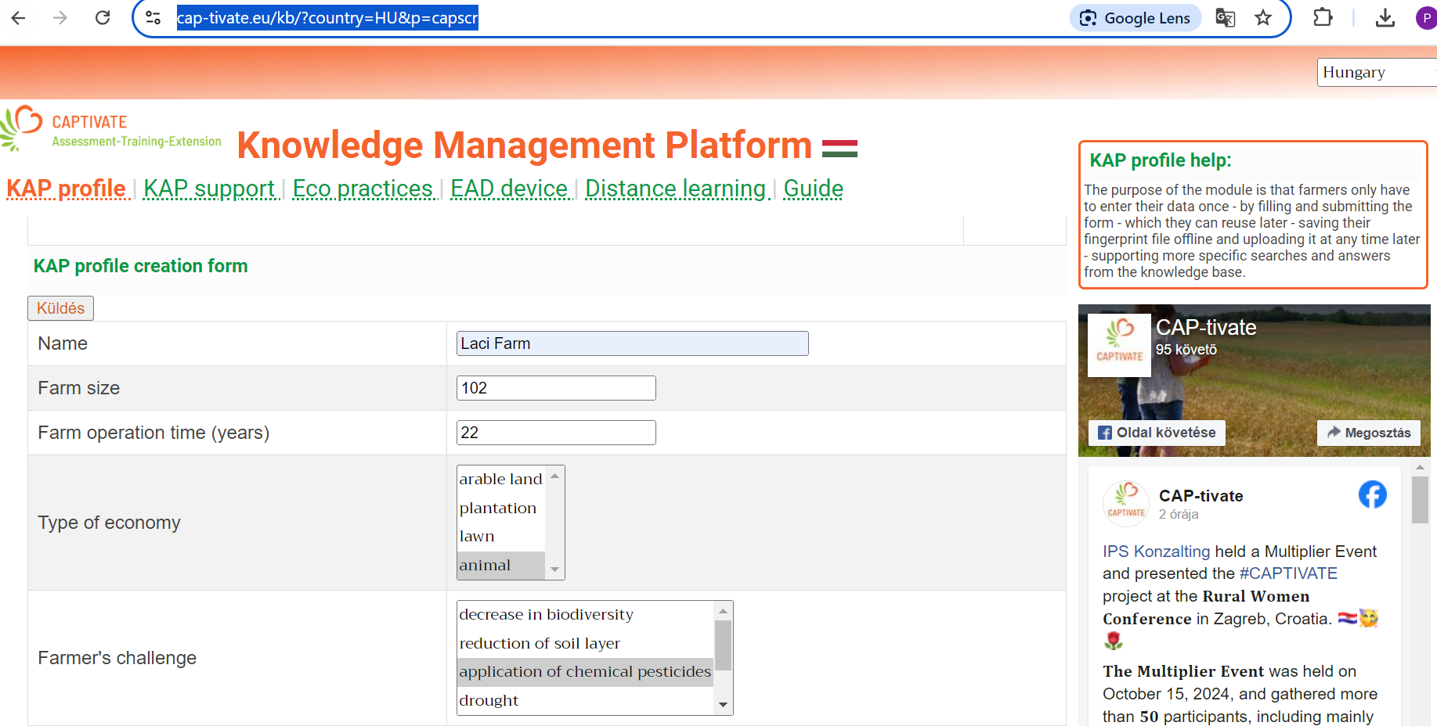
Farm CAP profile
Filling out a short questionnaire at start allows the preparation of the farmer profile, to be reused during the searches for relevant content.
The purpose of this function:
to allow the user to search and get response more specifically in the Knowledge Base on the basis of the profile data provided,
the farmer only needs to enter his own data once during use, which can be re-used at any time later (one click to return to the interface),
no need for a full user registration in the system (this is also possible), but the possibility to enter the relevant data quickly, in a few seconds.
save profile file to desktop, and reload later

Slide 6
CAP Measures - structure
A key element of the Knowledge Base is a searchable, filterable database of grant applications, subsidies, payments, closely linked to eco-management techniques.
Due to its complex nature, the content is processed and displayed according to a specific structure designed for the purpose.
  The CAPTIVATE experts can use a tree editor tool developed for this purpose, where the different elements of the measures can be arranged in a hierarchical, tree-like structure.
  During processing, the complex documents are logically and functionally decomposed and entered according to specific content element types, and keywords (providing links to other modules), to the knowledge base.
The main preset properties of the content element types are: measure, sub-measure, entitlement, commitment, regulation, rule, practice, CAPTIVATE section. Each element can appear anywhere in the tree structure, currently maximum of six levels.
Another important tool for describing content is keyword indexing, according to the specific interests of users, to make content easily searchable. Keywords can be grouped into three main categories according to their origin:
Keywords from the answers of users filling in the CAP profile form (during the so-called fingerprinting process)
Keywords from the presentation of the results of the EAD tool, eco-themes and farms, in combination with the Eco-practices module.
Content description keywords, flexibly set by content editors who upload CAP measures.
Notes:
The content processing tool has also developed a flexible, dynamic procedure for this, allowing each national content editor to introduce new keyword types and their associated optional values. Accordingly, the keywords may even be completely different from country to country (except for the system keywords ensuring the links between modules).

Slide 7
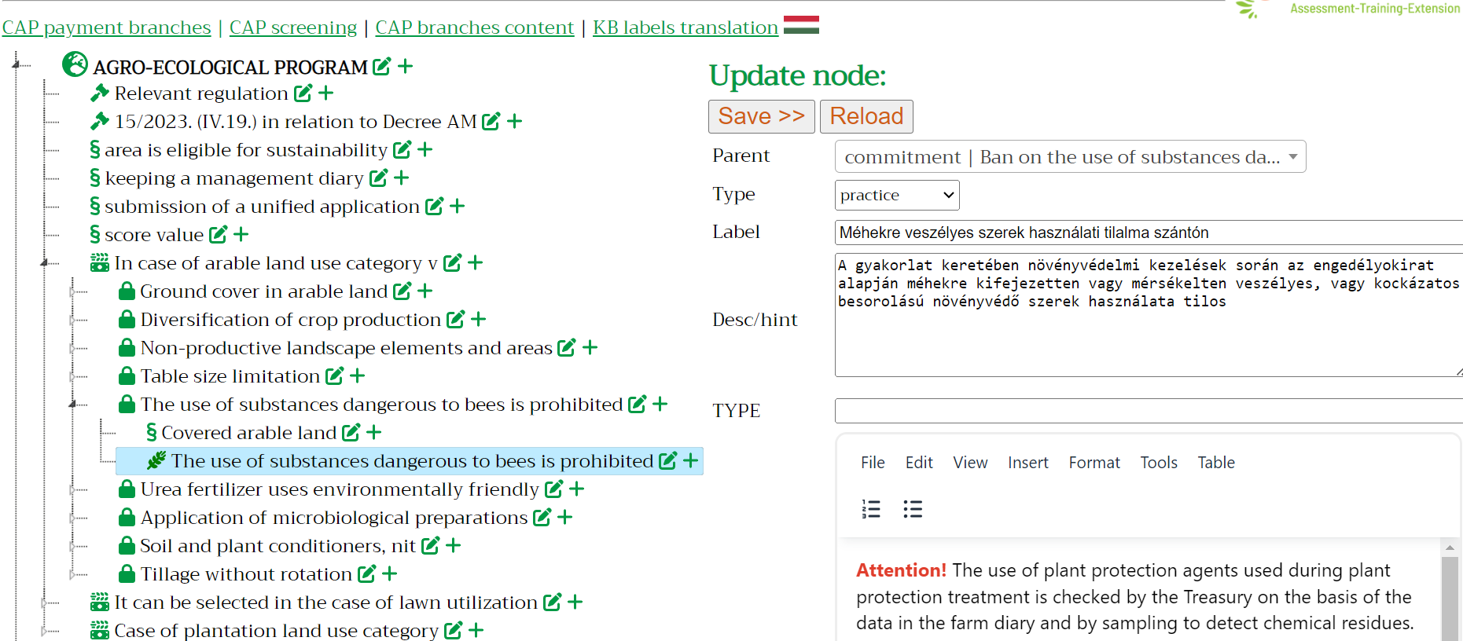
CAP Measures - backend

Slide 8
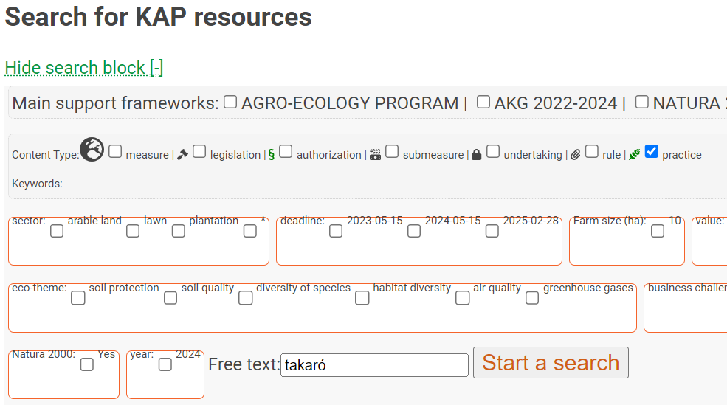
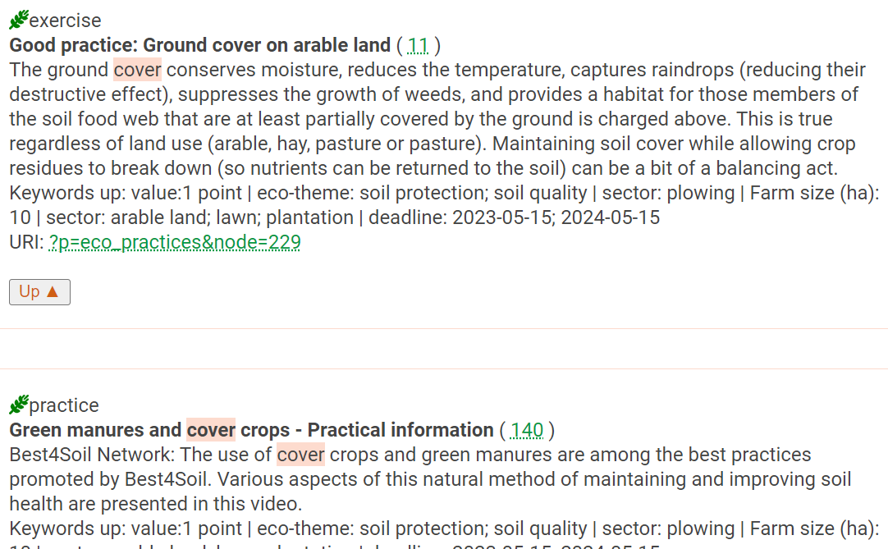
CAP Measures – search an results

Slide 9
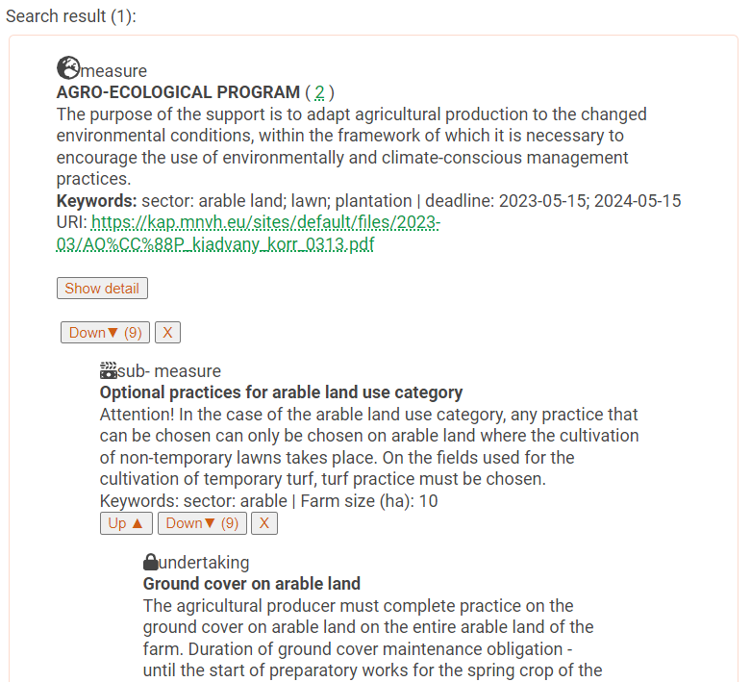
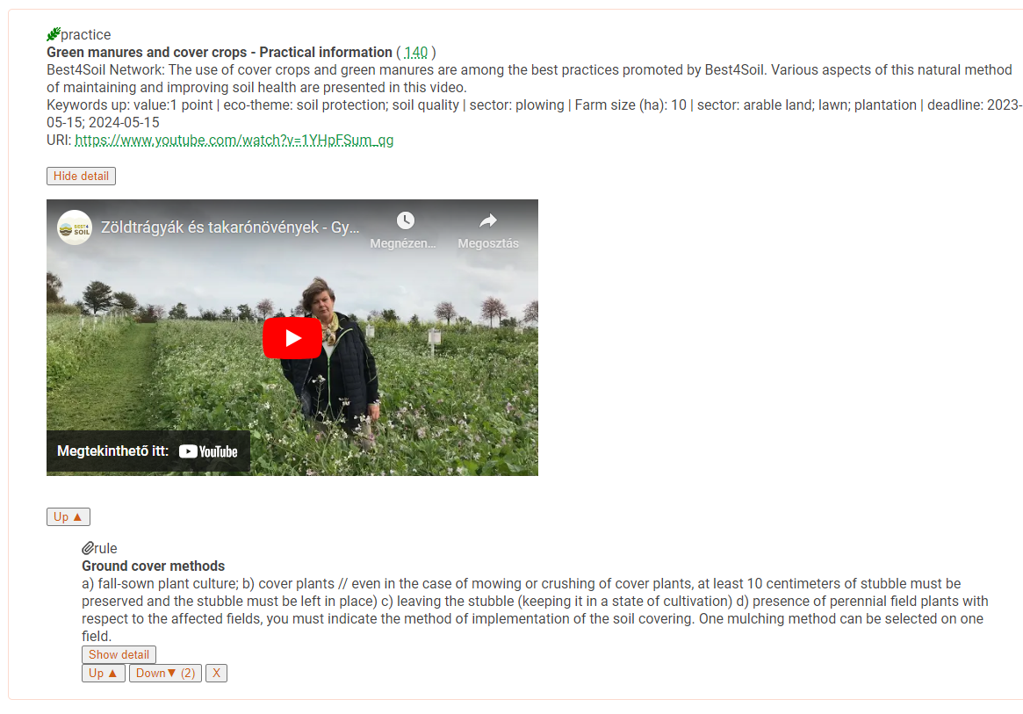
CAP Measures – navigation and details
Notes:
The content processing tool has also developed a flexible, dynamic procedure for this, allowing each national content editor to introduce new keyword types and their associated optional values. Accordingly, the keywords may even be completely different from country to country (except for the system keywords ensuring the links between modules).

Slide 10
Eco-practices
In CAPTIVATE's vocabulary, eco-practices are defined as farming practices that enable farmers to move their farms into a more sustainable direction, which can be environmentally friendly, regenerative, precision, climate resilient (or adaptive), etc., in particular if they are 1) well supported by technical and economic evidence, and 2) are part of a CAP support programme (CAPTIVATE project focus).
The content of this part of the Knowledge Base is built on the international practice of FiBL, which was used as the start for the initial data set, to which the national resources in the three target countries (Croatia, Hungary, Slovakia) and other individual country-specific national resources were added and linked.
The practices have been classified according to the same taxonomic system, and using keyword indexing, which are identical to those used for the CAP support module and the EAD tool.
Search block:
As the collection of practices is developed as a stand-alone content type on the CAPTIVATE web content management system (Drupal) platform, with two main taxonomy lists and several other descriptive data fields, the search form also uses this technical platform.
Notes:
The content processing tool has also developed a flexible, dynamic procedure for this, allowing each national content editor to introduce new keyword types and their associated optional values. Accordingly, the keywords may even be completely different from country to country (except for the system keywords ensuring the links between modules).

Slide 11
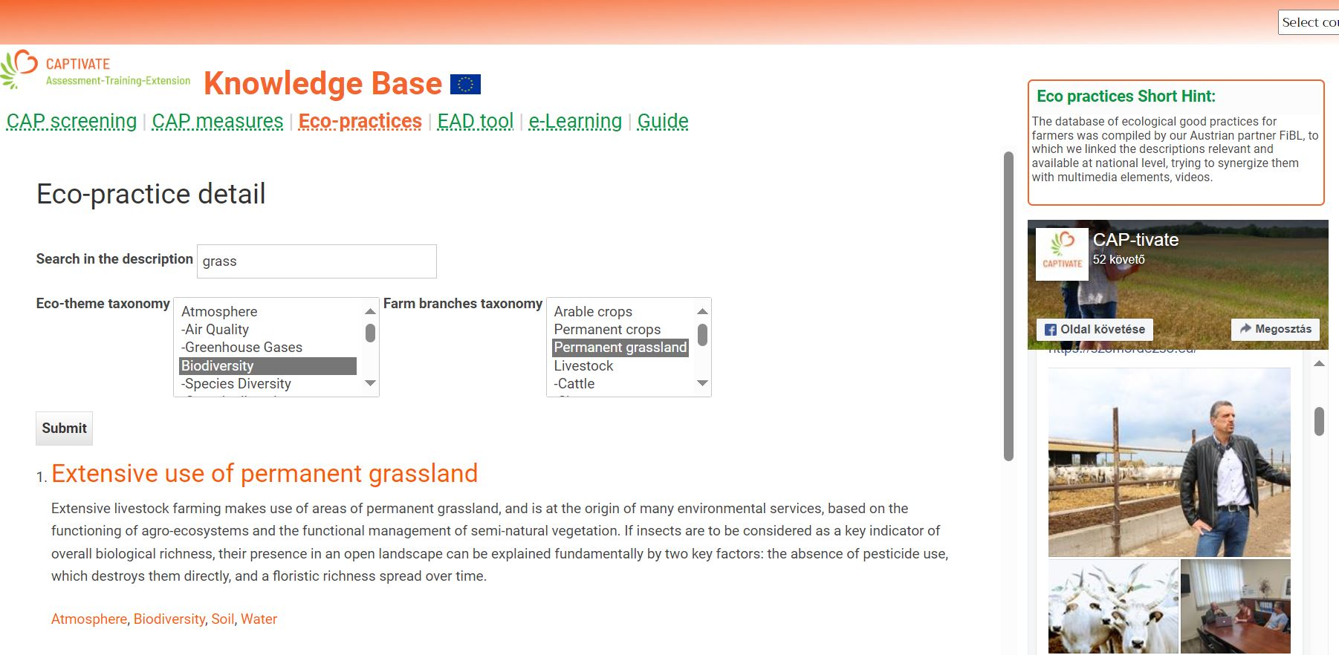
Eco-practices – list
Notes:
The content processing tool has also developed a flexible, dynamic procedure for this, allowing each national content editor to introduce new keyword types and their associated optional values. Accordingly, the keywords may even be completely different from country to country (except for the system keywords ensuring the links between modules).

Slide 12
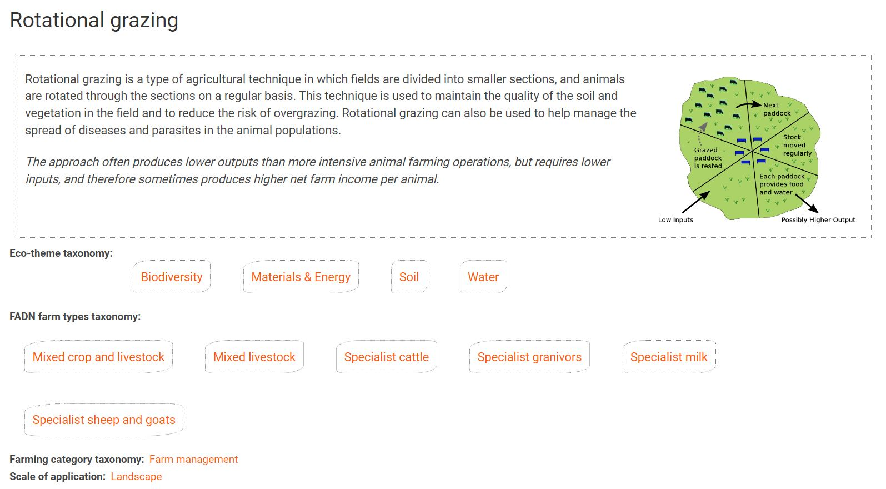
Eco-practices – detail page
Notes:
The content processing tool has also developed a flexible, dynamic procedure for this, allowing each national content editor to introduce new keyword types and their associated optional values. Accordingly, the keywords may even be completely different from country to country (except for the system keywords ensuring the links between modules).

Slide 13
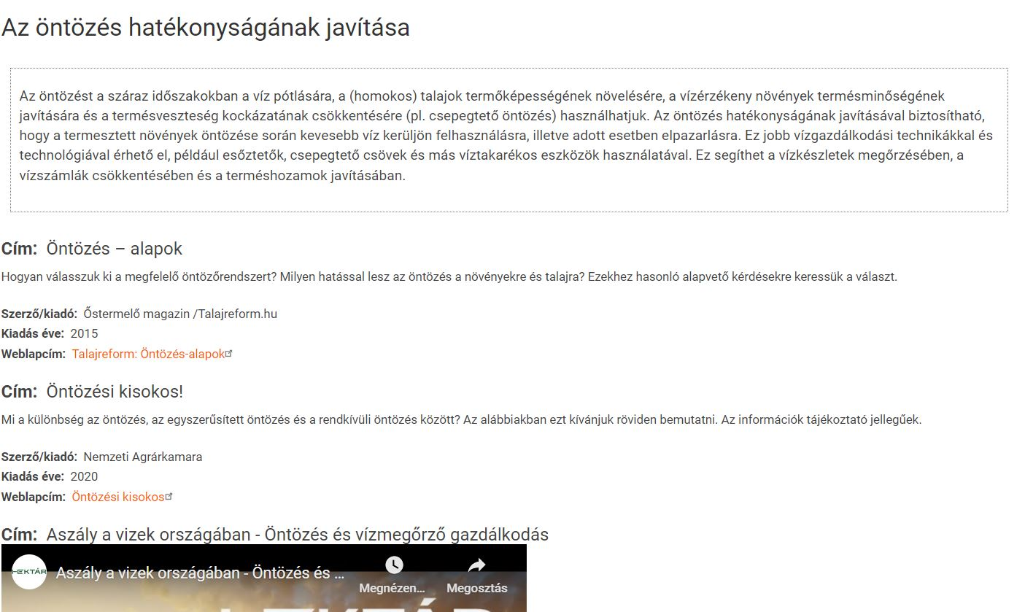
Eco-practices – national resources
The national detail page provides the translation of the core English record, and a repeatable section of additional information relevant at the national level, with more description, video embedding, attachment of files, URLs, etc.
Notes:
The content processing tool has also developed a flexible, dynamic procedure for this, allowing each national content editor to introduce new keyword types and their associated optional values. Accordingly, the keywords may even be completely different from country to country (except for the system keywords ensuring the links between modules).

Slide 14
Connections
Navigating through the CAPTIVATE pathway is achieved by CONNECTIONS between the various modules of the platform
CAP measures - Eco practice knowledge base
  When adding a practice type of paragraph in the tree editor, the URL field can be filled in with the hyperlink value of the practice description in the knowledge base. It is preferred to provide here the URL reference of an eco-practice described in our repository.
EAD results – Eco-practice knowledge repository
  According to eco-theme and subtheme properties of the various assessment indicators, and the same keywords assigned to the eco-practices, the link is established between the two modules. The recommended practices are displayed on the EAD results page, ranking (highlighting) from the weakest to the stronger themes. Similarly, the farm branch category is calculated from the Kobo response, and then linked to eco-practices which have the same category items assigned.
EAD results – CAP measures browser
  Here the method is the same as for the eco-practices on the results presentation side, only that the displayed, recommended, and linked measures are located under the tree view tool, where thy should be tagged with matching keywords, as the eco-themes or farm branches.
Moodle glossary – EAD tool questions and hints glossary links (via xml file export and processing)
Notes:
The content processing tool has also developed a flexible, dynamic procedure for this, allowing each national content editor to introduce new keyword types and their associated optional values. Accordingly, the keywords may even be completely different from country to country (except for the system keywords ensuring the links between modules).

