Slide 1
Captivate
Assesment – Training - Extension
Project context, motivations, goals and ambitions
KA220-VET - Cooperation partnerships in vocational education and training
2021.11.01-2024.10.31

Slide 2
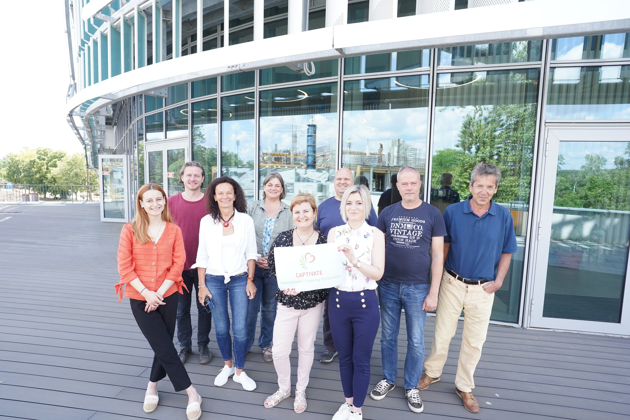
The consortium
ÖMKi (Research Institute of Organic Agriculture, Hungary)
NJE (Neumann János University, Kecskemét)
FIBL Österreich, Austria
AGROINSTITUT NITRA, Slovakia
IPS Konzalting, Croatia

Slide 3
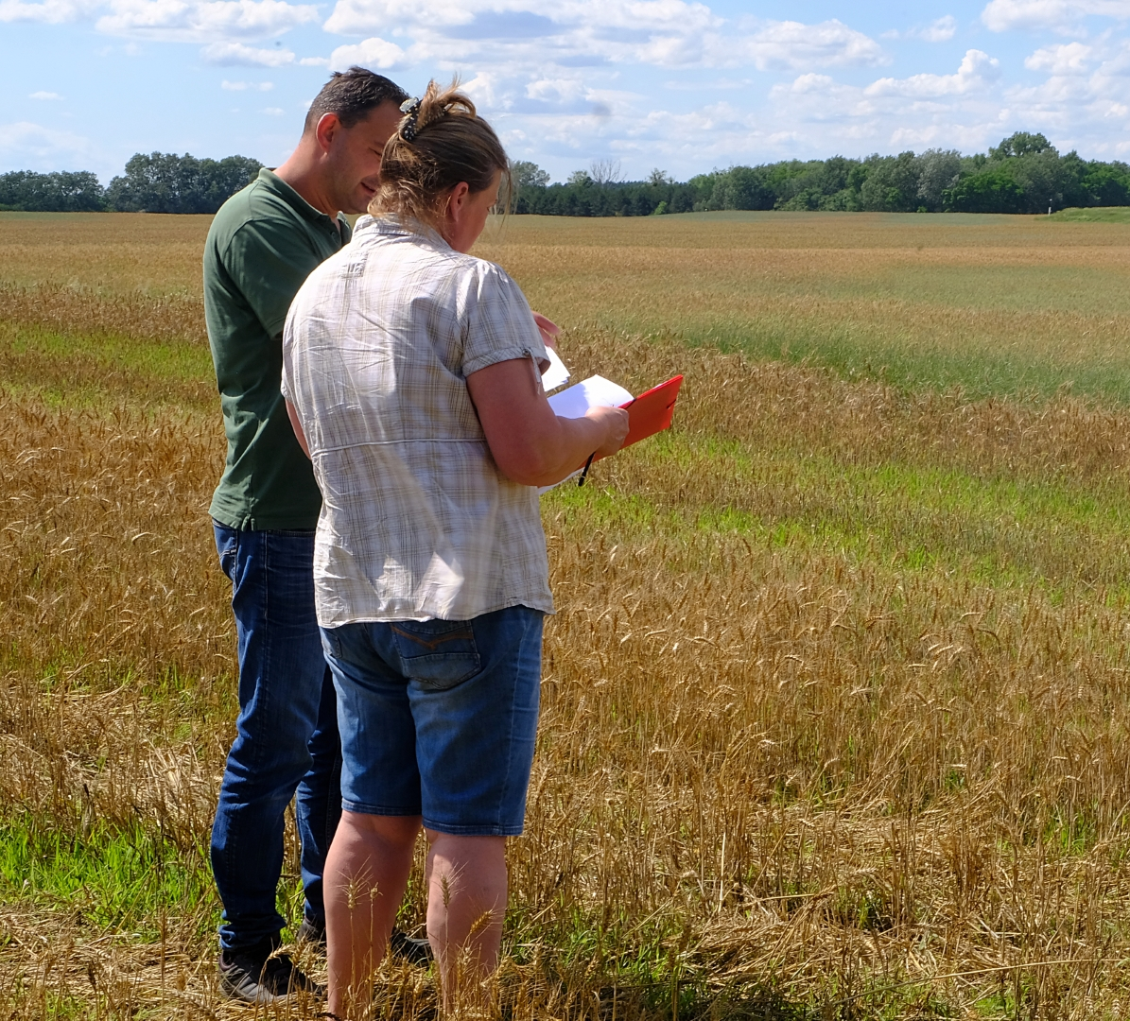
Context
Farmer’s motivations, ambitions, goals
Payments from CAP
Regulations: commitments ands limitations
Policy
Grean deal
Farm to Fork
Biodiversity strategy
Soil mission
Organic action plan
Advisory services

Slide 4
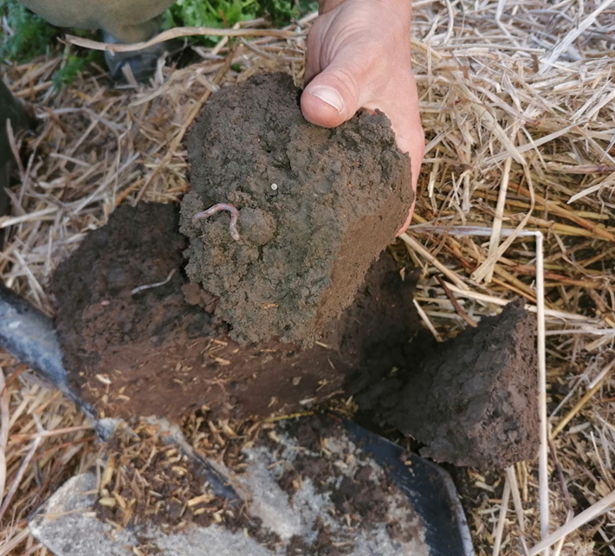
Aims and results
Develop a platform for CAP „greening measures” – linked to good practices
Develop a self-assessment tool for environmental performance of farms – linked to good practices
Develop a learning platform – linked to good practices

