Slide 1
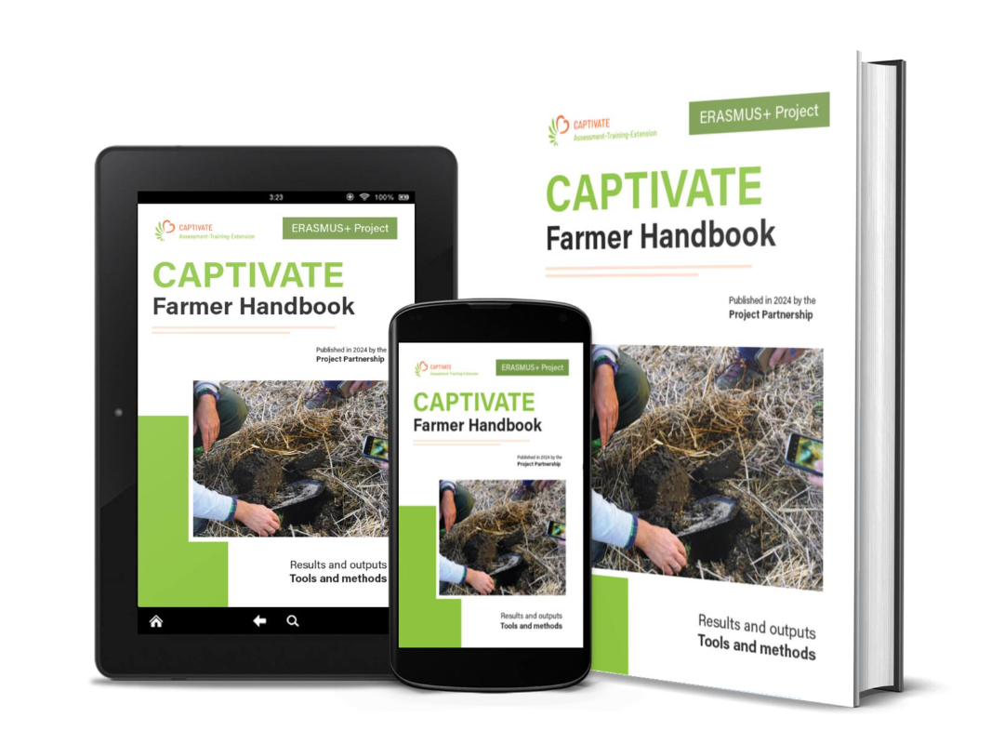
CAPTIVATE
Farmer Handbook
Ana-Marija Špicnagel, IPS Konzalting
21 October 2024

Slide 2
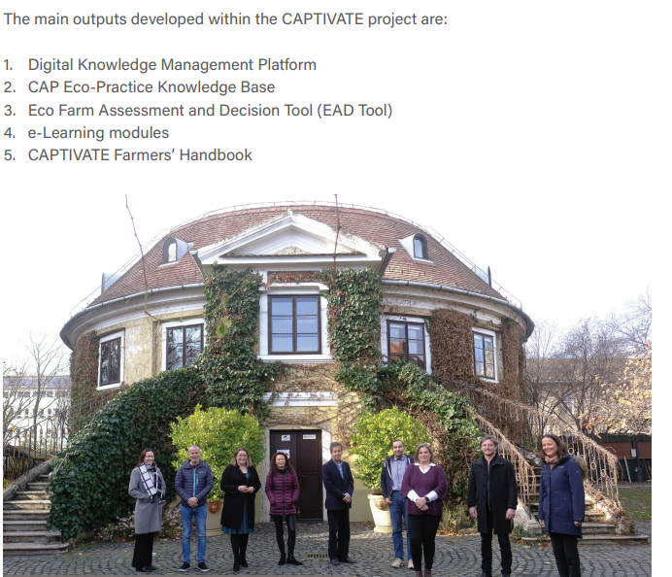
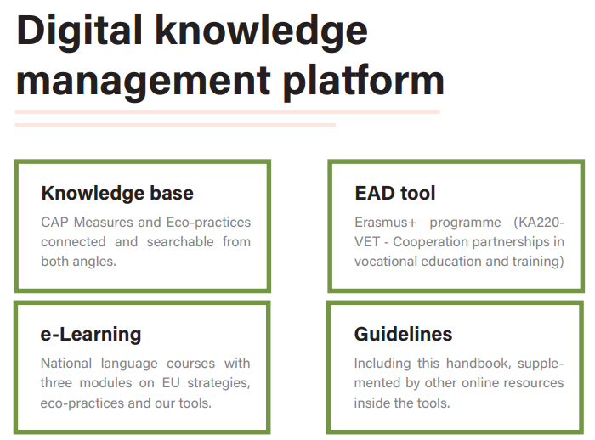
Main results

Slide 3
Farmers Handbooks
5 key chapters:
Introduction and background
Knowledge Management Platform
EcoFarm Assessment Decision Tool
E-Learning course on green skills
Feedback and way forward

Slide 4
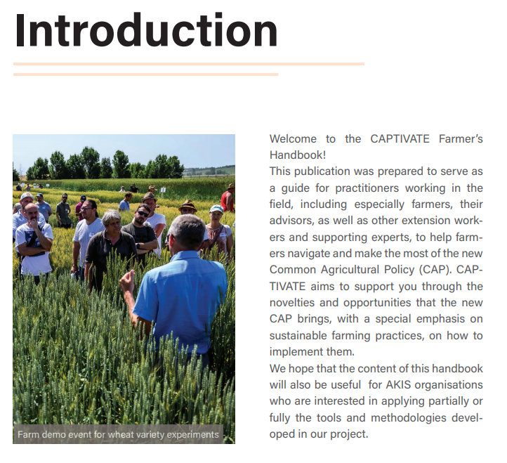







Farmers Handbook

Slide 5

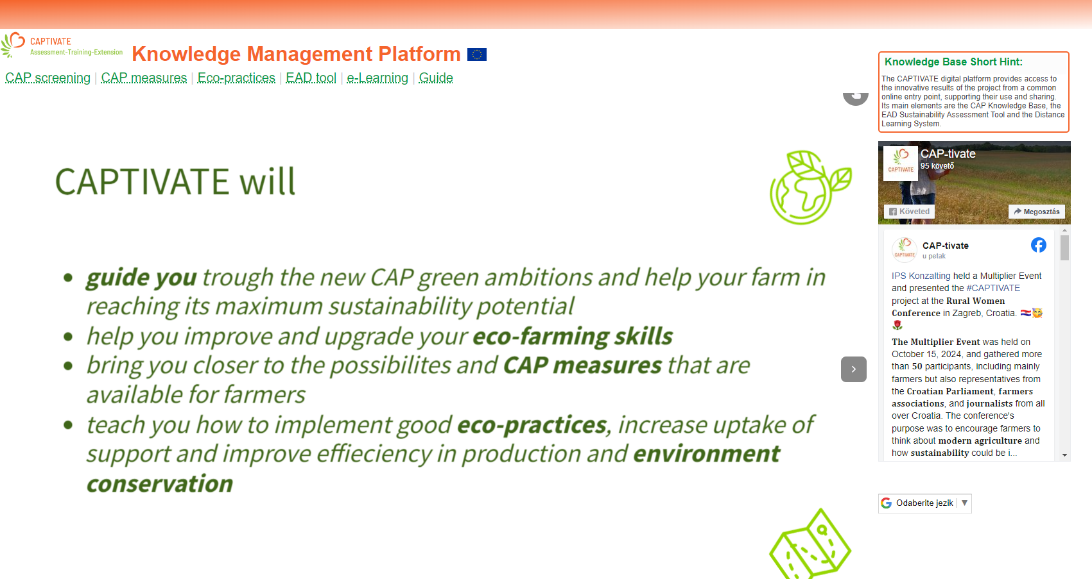
Knowledge Management Platform

Slide 6
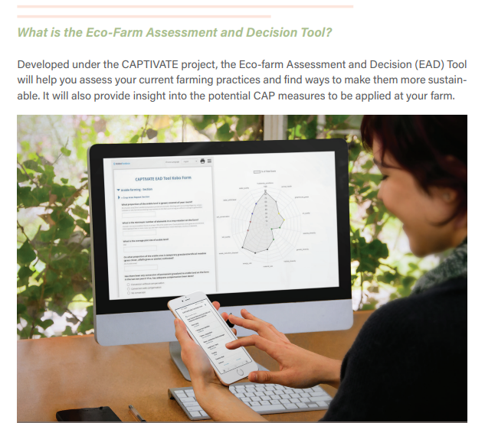
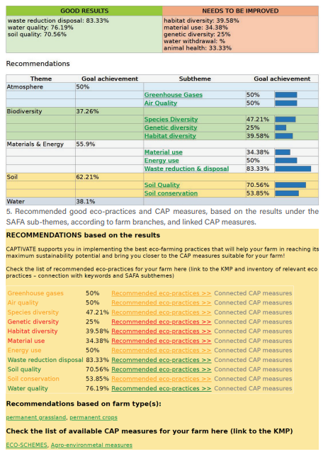
Eco-farm Assessment and Decision Tool (EAD)

Slide 7

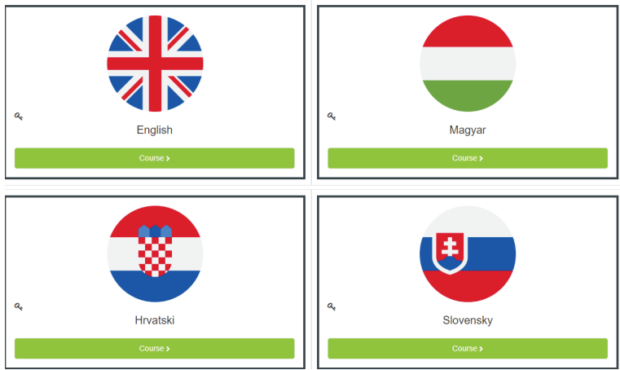
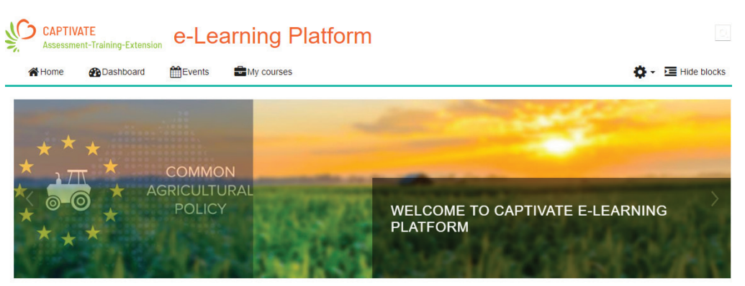
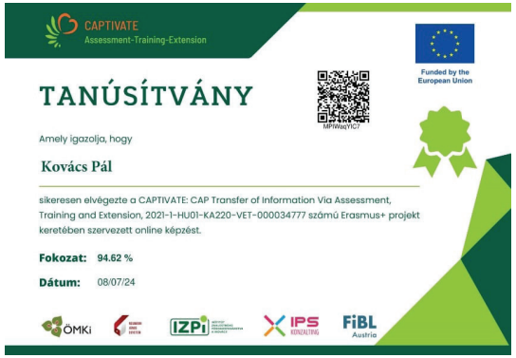
E-learning modules

Slide 8
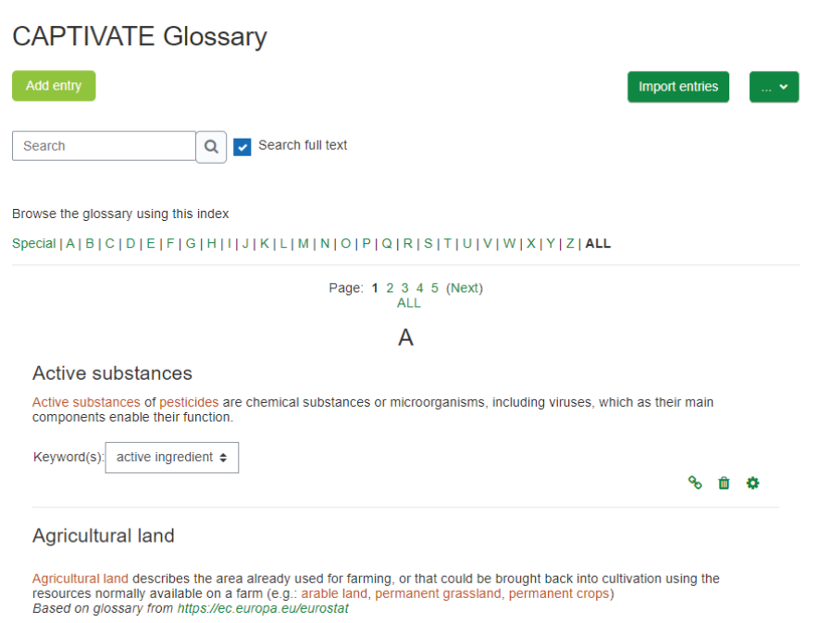
Glossary

Slide 9



Policy recommendations

Slide 10
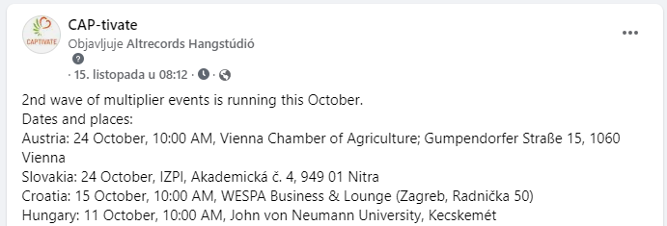
Multiplier events

Slide 11
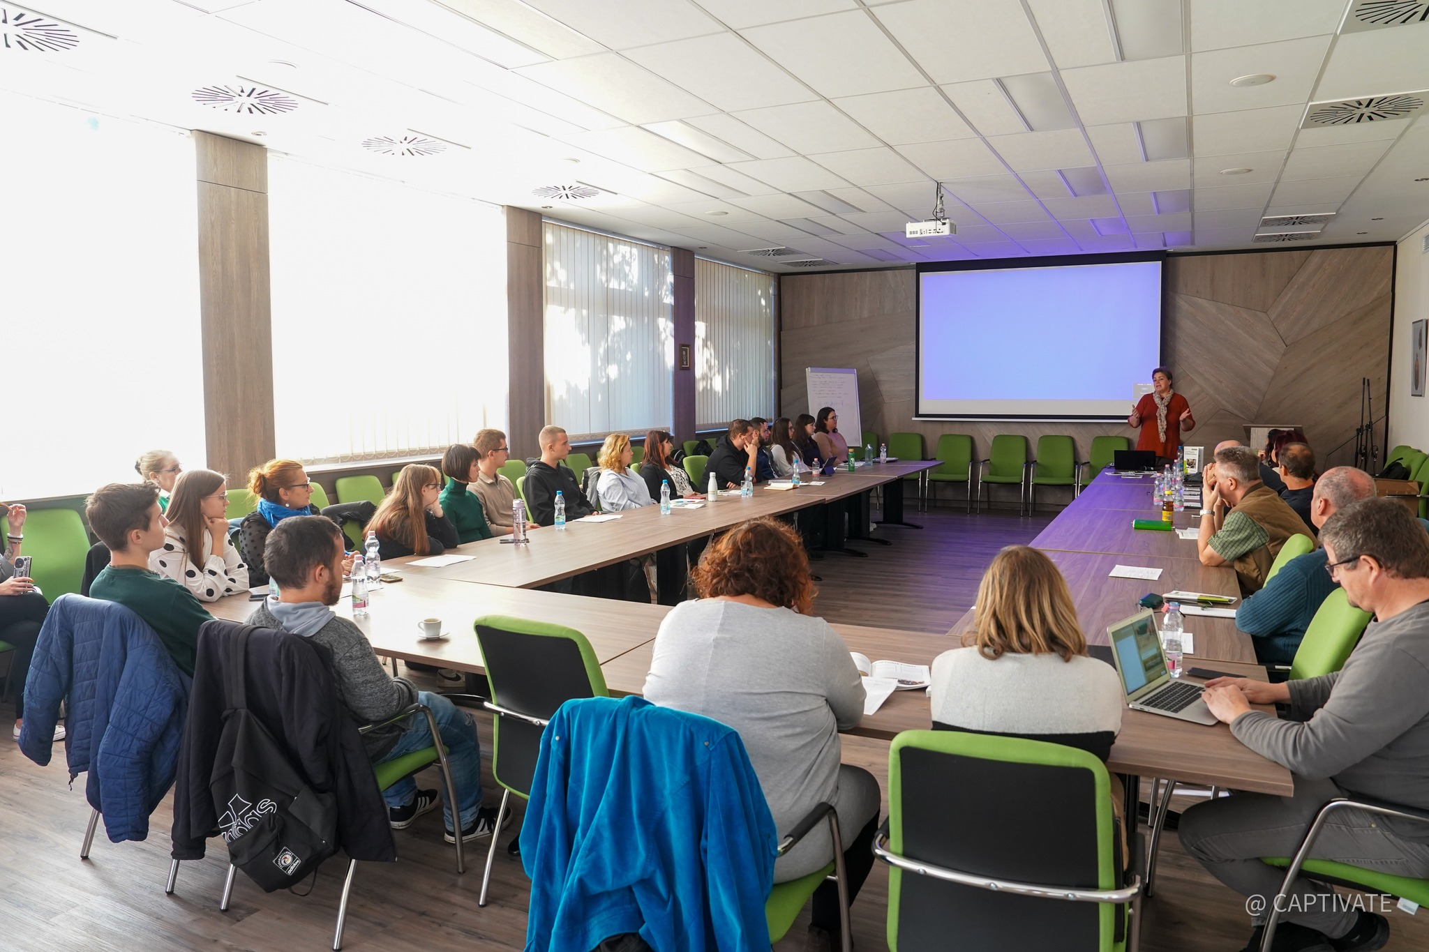
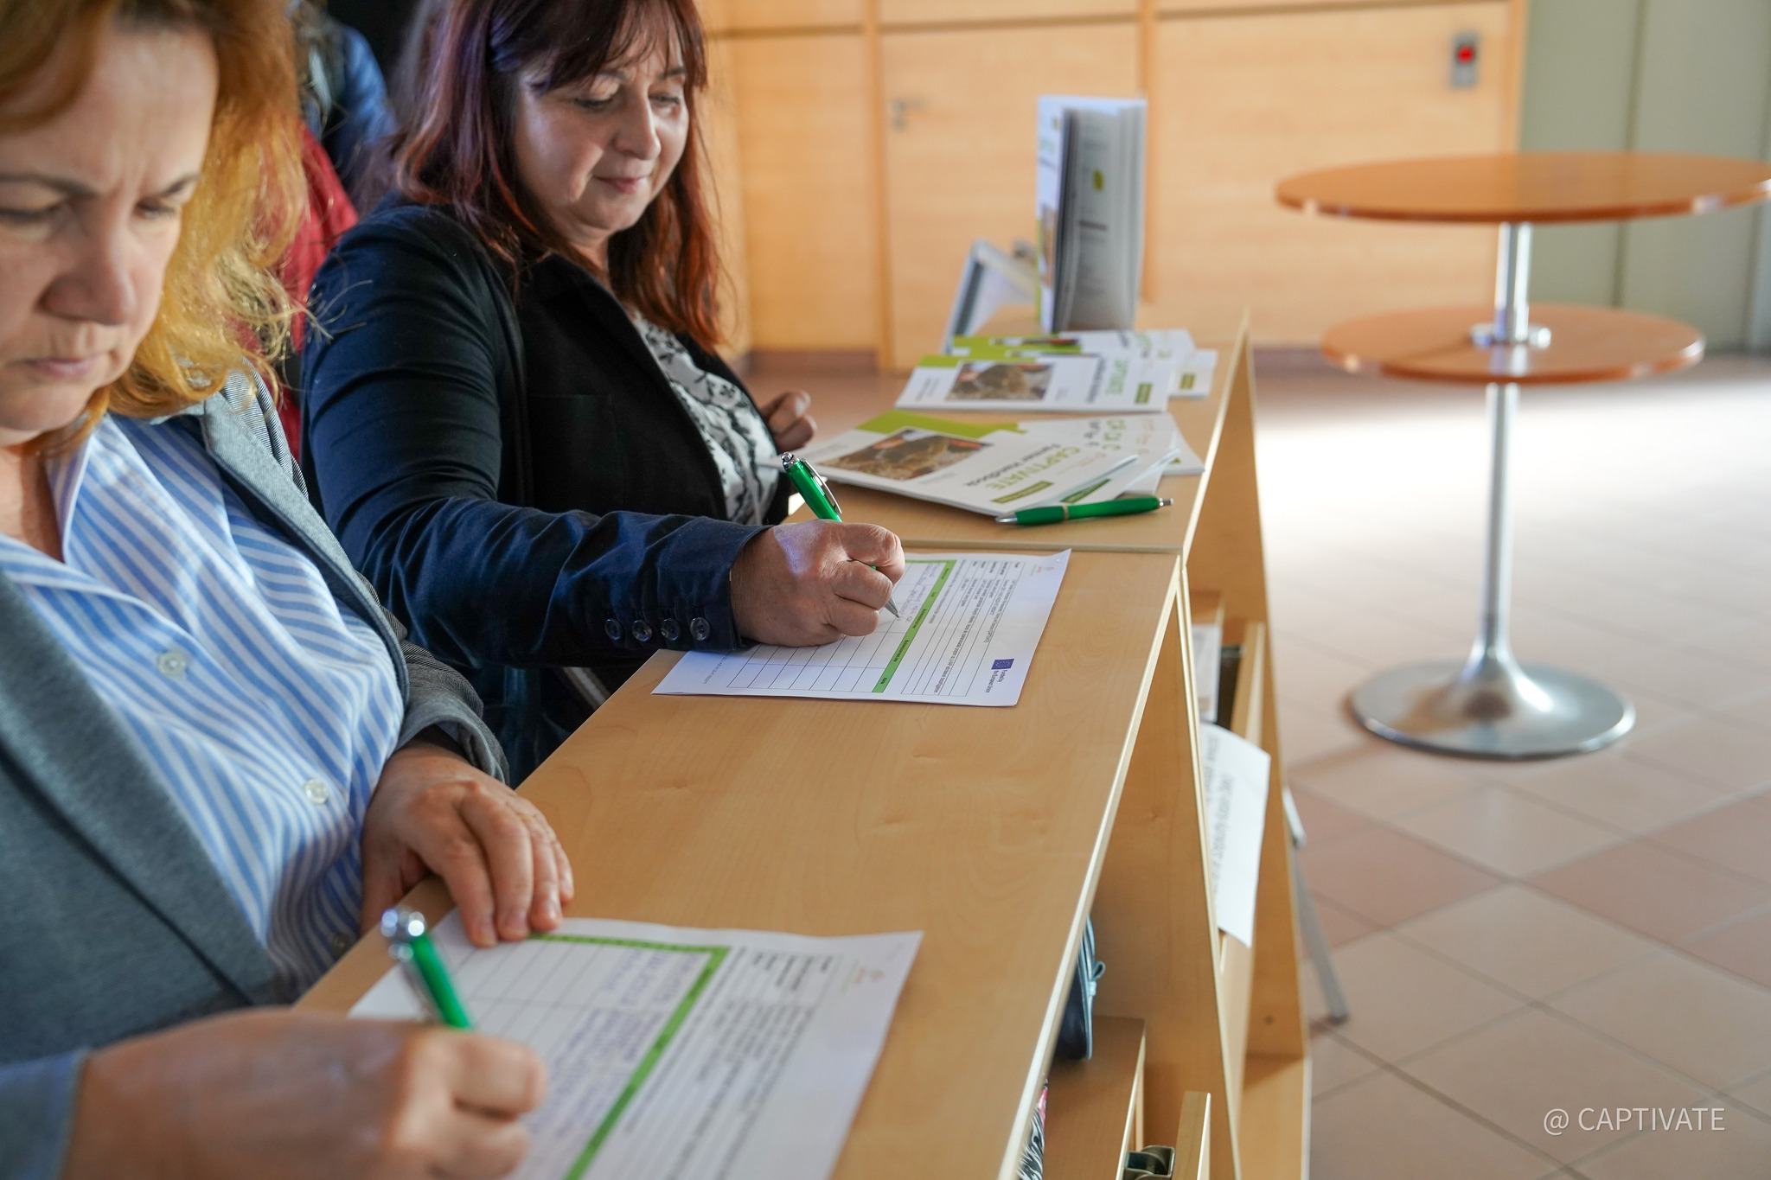
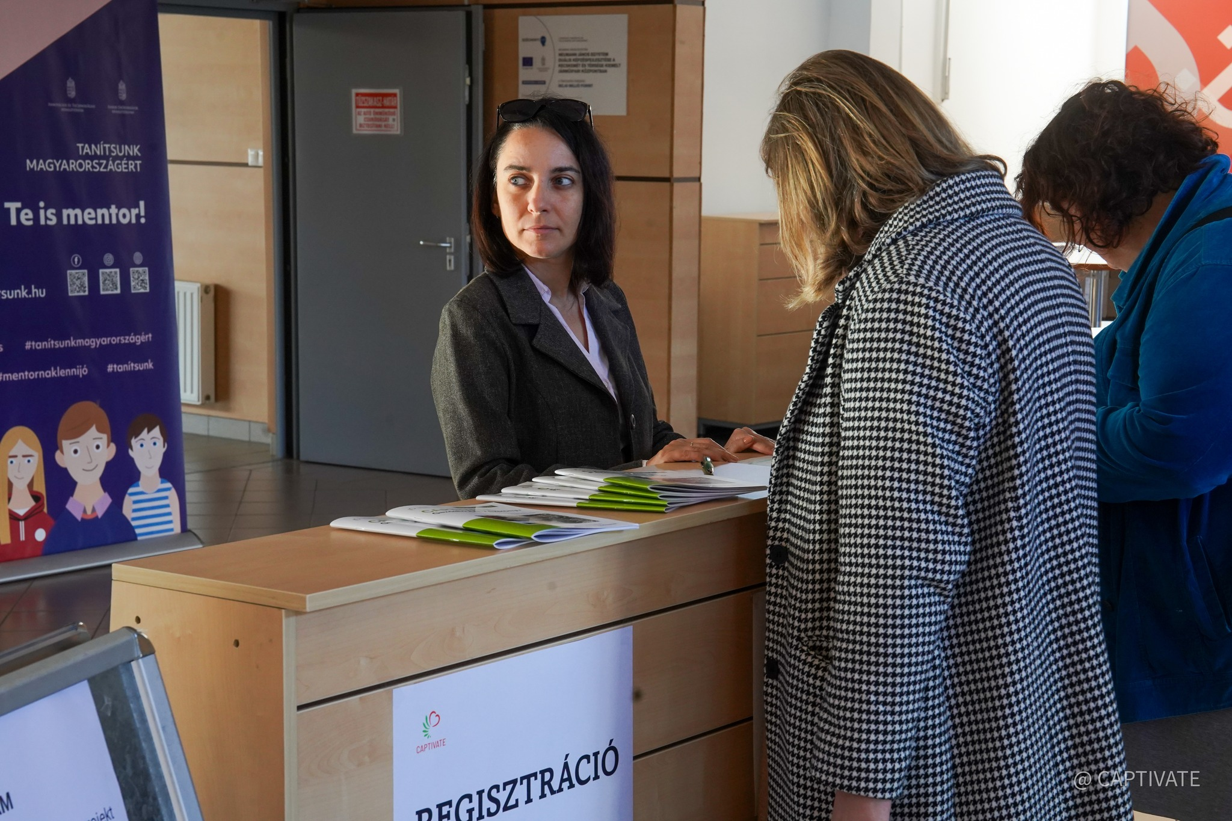
Multiplier event - Hungary

Slide 12
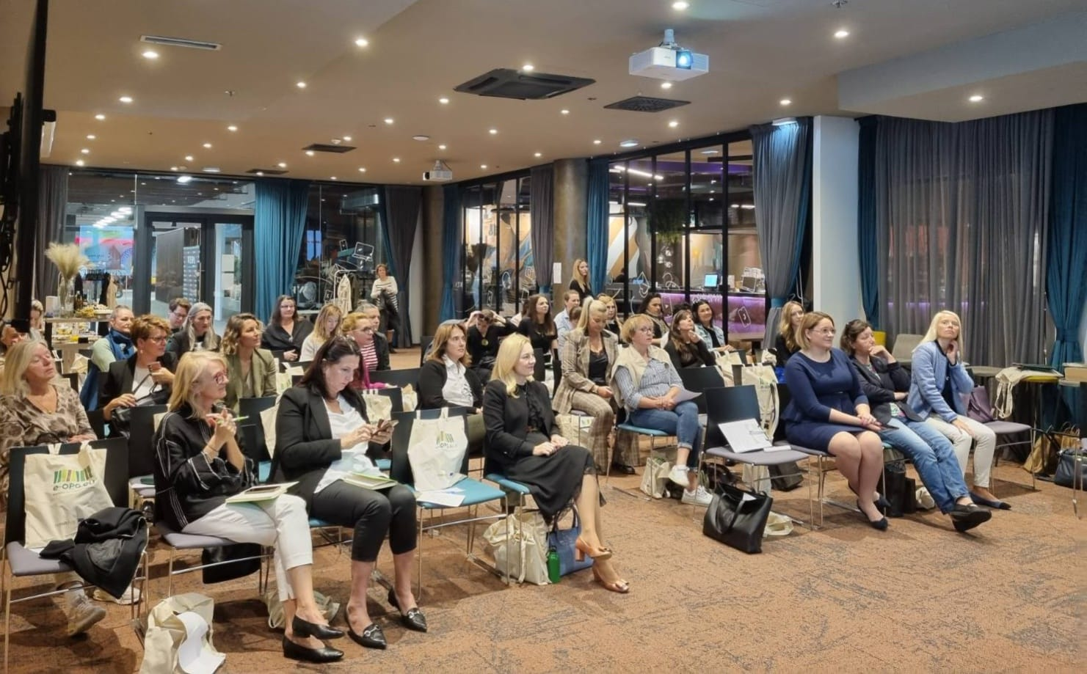
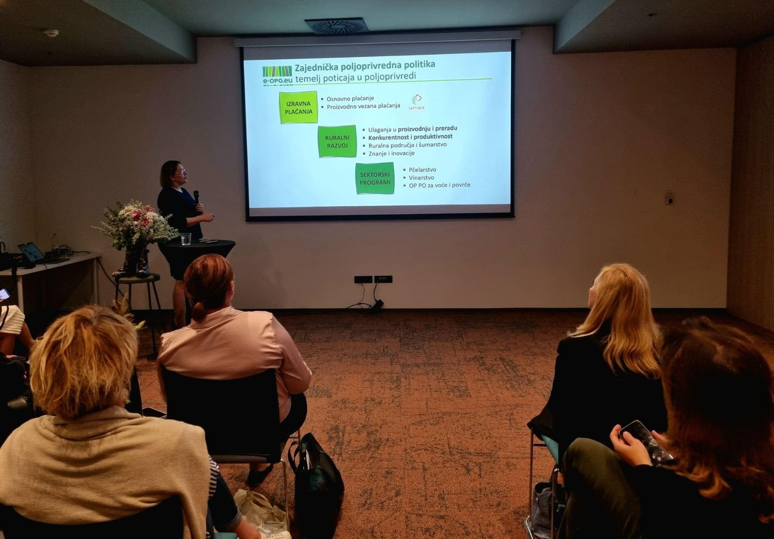
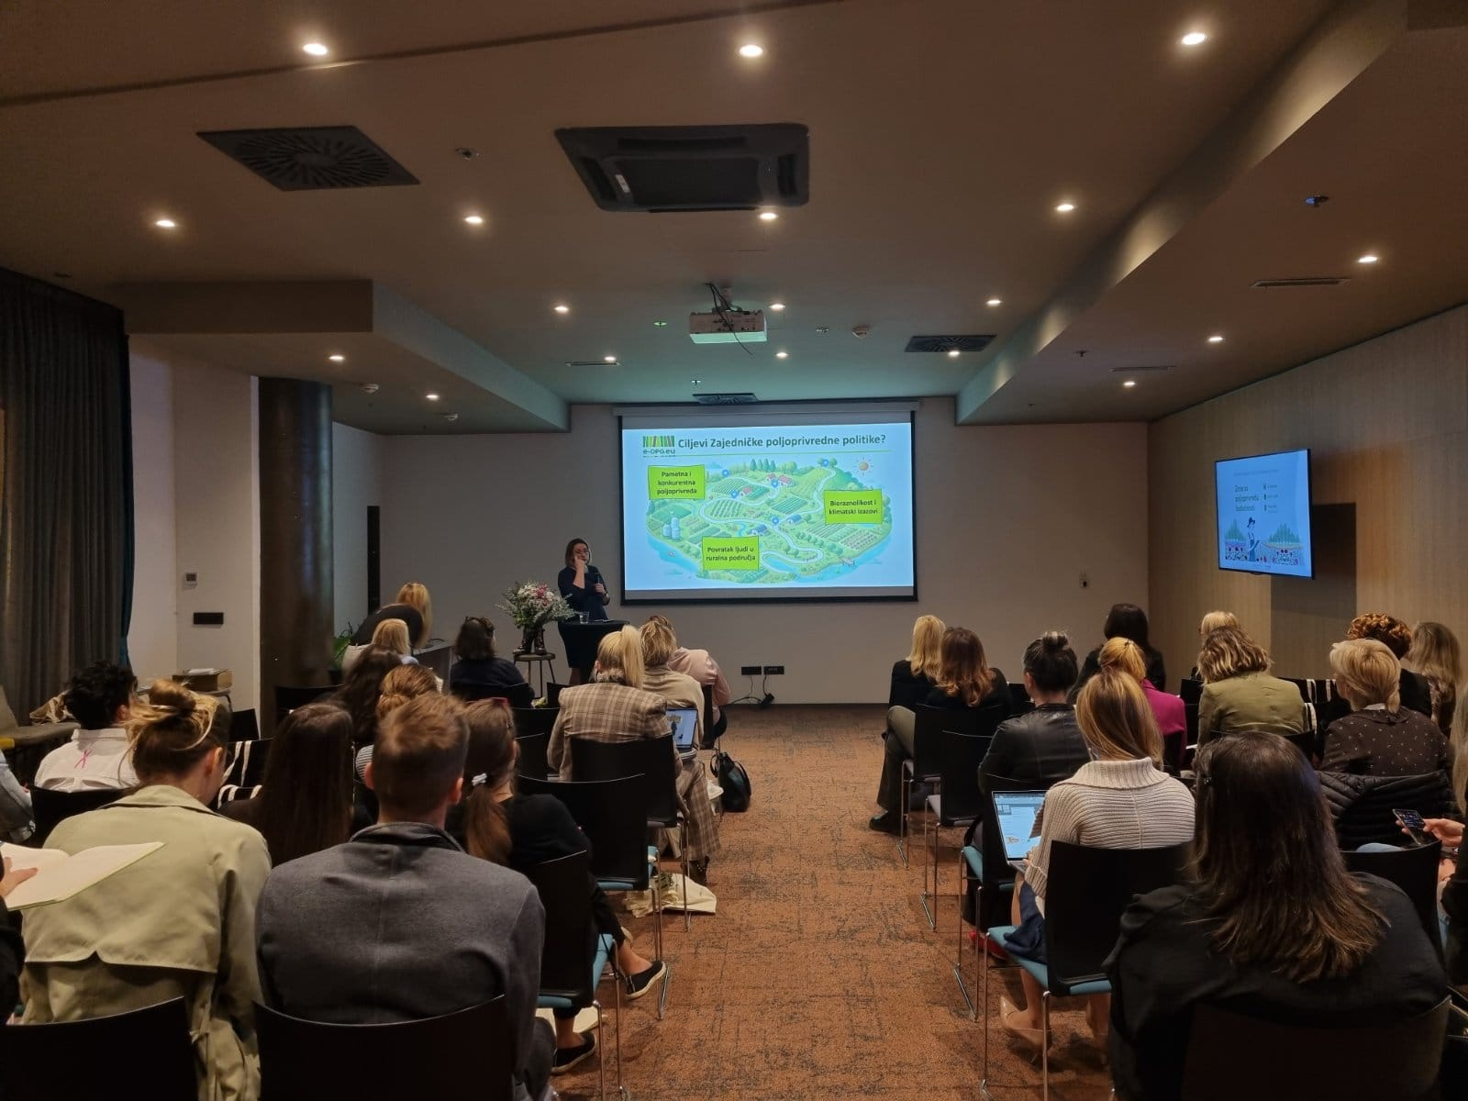
Multiplier event - Croatia

Slide 13









