Slide 1
Eco-Farm Assessment & Decision Tool for sustainable farms
CAPTIVATE Eco-Farm Assessment & Decision Tool
CAP Transfer of Information Via Assessment, Training and Extension

Slide 2
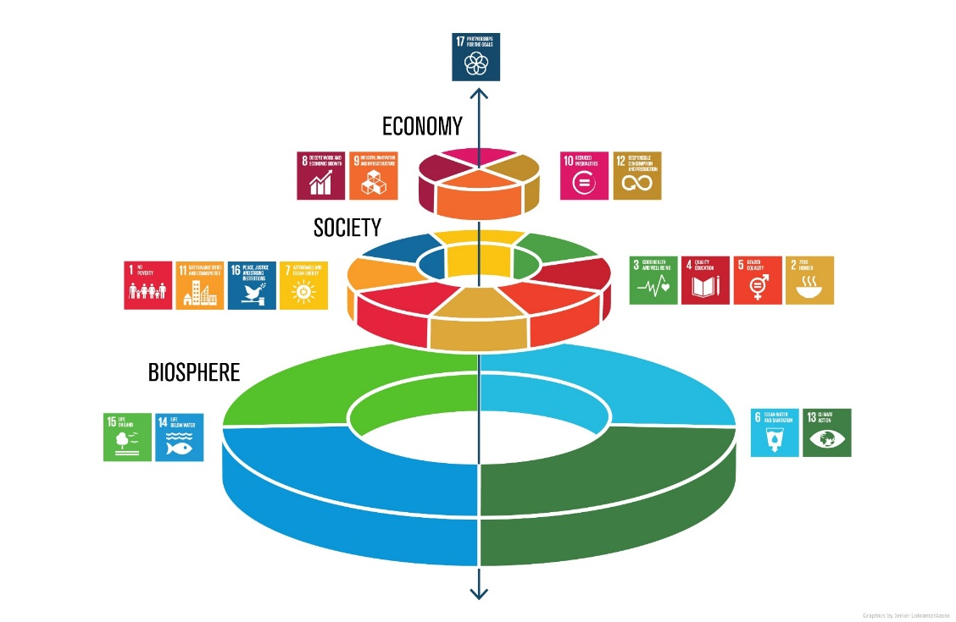
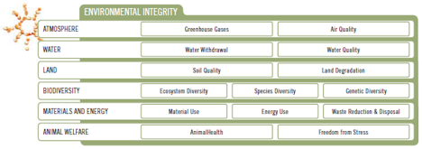
CAPTIVATE Eco-Farm Assessment & Decision Tool
CAP Transfer of Information Via Assessment, Training and Extension
Development process and final configuration
1. Main properties and delimiting parameters
-> increase on-farm ecological sustainability
-> also socio-economic aspects (supplementary risk assessment) to reflect complex system interactions
-> beyond sustainability assessment: benchmarking, capacity building, knowledge management, decision support, and communication of results.
-> respond to different geographical settings according to the project countries (Hungary, Slovakia, and Croatia).

Slide 3
CAPTIVATE Eco-Farm Assessment & Decision Tool
CAP Transfer of Information Via Assessment, Training and Extension
Development process and final configuration
2. System boundaries to describe the framework of the system under study
-> 10 most important farm types (FADN)
-> include entire farm, encompassing all branches of farming
-> agricultural sector and primary production (excluding tourism, processing, etc.).
-> area observed includes the agricultural area, husbandry, and effects on and through nearby areas
Mixed crops and livestock
Specialist COP (Cereals, Oilseeds and Protein crops)
Specialist milk
Specialist sheep and goats
Mixed crops
Specialist other fieldcrops
Mixed livestock
Specialist cattle
Specialist wine
Specialist horticulture
Specialist olives
Specialist granivores
Specialist orchards - fruits
Permanent crops combined
Notes:
with a sum of at least 90% of farms and of agricultural area in each project country, excluding e.g. mushrooms, beekeeping and forestry. Farm accountancy data network
-> include entire farm, encompassing all branches of farming, but limiting its scope to the agricultural sector and primary production (excluding tourism, processing, etc.).
-> area observed includes the agricultural area (excluding home gardens, private areas with trees, etc.), husbandry (excluding animals for private use), and effects on and through nearby areas.

Slide 4
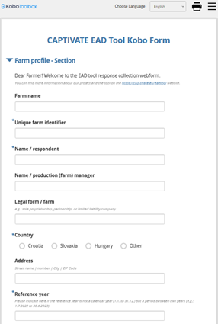
CAPTIVATE Eco-Farm Assessment & Decision Tool
CAP Transfer of Information Via Assessment, Training and Extension
Development process and final configuration
3. Structure of the tool based on alignment and the aimed properties
-> Multi-Criteria Analysis
-> Level of detail was determined by the need for user- friendliness and easy applicability
-> Aim was that users are able to conduct a self- assessment within two hours of time
Notes:
Structure of the tool based on alignment and the aimed properties were discussed with selected experts of the participating project countries and the whole CAPTIVATE project team.
Development of indicator set, we reflected on criteria and indicators of existing tools and standards for sustainability assessment and scientific literature.

Slide 5
CAPTIVATE Eco-Farm Assessment & Decision Tool
CAP Transfer of Information Via Assessment, Training and Extension
Development process and final configuration
4. Selection and development of indicator set
sources i.e. SAFA Guidelines and SMART Farm Tool (Sustainability Monitoring and Assessment Routine)
-> mostly practice based indicators
Number: Farm in general – 14; Animal husbandry – 42 (species);
Plant production – 40 (branches); Socio-Economic RA – 24;
Ecology RA – 22;
Weighting process: impact on each eco-subtheme
Languages – English, Hungarian, Croatian, Slovakian
Assessments: 68
Notes:
Development of indicator set, we reflected on criteria and indicators of existing tools and standards for sustainability assessment and scientific literature.
assess farm practices or technical means. They are rather process-oriented than outcome oriented.

Slide 6

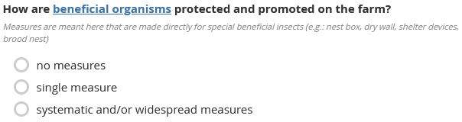
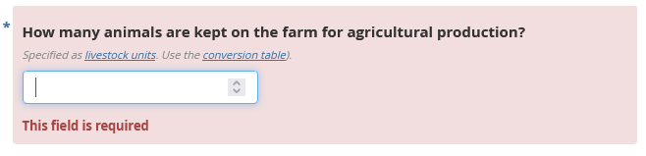
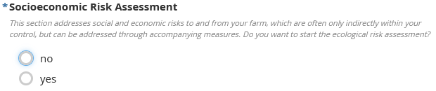
CAPTIVATE Eco-Farm Assessment & Decision Tool
CAP Transfer of Information Via Assessment, Training and Extension
Development process and final configuration
KOBO Toolbox
Notes:
KOBO=data collection tool for challenging settings and provide it for free to nonprofit organizations.

Slide 7
CAPTIVATE Eco-Farm Assessment & Decision Tool
CAP Transfer of Information Via Assessment, Training and Extension
Development process and final configuration
Results
Main data of the farm
Radar chart - showing the farm performance by eco-themes (SAFA sub-themes) in percentages, compared with the “ideal farm” (goal)
Good results above 70%, weaker results (“needs to be improved”) under 40%
List of subtheme goal achievement
Recommended good eco-practices and CAP measures, based on the results under the SAFA sub-themes, according to farm branches, and linked CAP measures.
List of indicators which are contributing the most to stronger and weaker results (making the more positive or negative impacts)
Risk assessment section

Slide 8
CAPTIVATE Eco-Farm Assessment & Decision Tool
CAP Transfer of Information Via Assessment, Training and Extension
Development process and final configuration
Results
Main data of the farm
Radar chart - showing the farm performance by eco-themes (SAFA sub-themes) in percentages, compared with the “ideal farm” (goal)
Good results above 70%, weaker results (“needs to be improved”) under 40%
List of subtheme goal achievement
Recommended good eco-practices and CAP measures, based on the results under the SAFA sub-themes, according to farm branches, and linked CAP measures.
List of indicators which are contributing the most to stronger and weaker results (making the more positive or negative impacts)
Risk assessment section

Slide 9
CAPTIVATE Eco-Farm Assessment & Decision Tool
CAP Transfer of Information Via Assessment, Training and Extension
Development process and final configuration
Results
Main data of the farm
Radar chart - showing the farm performance by eco-themes (SAFA sub-themes) in percentages, compared with the “ideal farm” (goal)
Good results above 70%, weaker results (“needs to be improved”) under 40%
List of subtheme goal achievement
Recommended good eco-practices and CAP measures, based on the results under the SAFA sub-themes, according to farm branches, and linked CAP measures.
List of indicators which are contributing the most to stronger and weaker results (making the more positive or negative impacts)
Risk assessment section

Slide 10
CAPTIVATE Eco-Farm Assessment & Decision Tool
CAP Transfer of Information Via Assessment, Training and Extension
Development process and final configuration
Results
Main data of the farm
Radar chart - showing the farm performance by eco-themes (SAFA sub-themes) in percentages, compared with the “ideal farm” (goal)
Good results above 70%, weaker results (“needs to be improved”) under 40%
List of subtheme goal achievement
Recommended good eco-practices and CAP measures, based on the results under the SAFA sub-themes, according to farm branches, and linked CAP measures.
List of indicators which are contributing the most to stronger and weaker results (making the more positive or negative impacts)
Risk assessment section

Slide 11
CAPTIVATE Eco-Farm Assessment & Decision Tool
CAP Transfer of Information Via Assessment, Training and Extension
Development process and final configuration
Results
Main data of the farm
Radar chart - showing the farm performance by eco-themes (SAFA sub-themes) in percentages, compared with the “ideal farm” (goal)
Good results above 70%, weaker results (“needs to be improved”) under 40%
List of subtheme goal achievement
Recommended good eco-practices and CAP measures, based on the results under the SAFA sub-themes, according to farm branches, and linked CAP measures.
List of indicators which are contributing the most to stronger and weaker results (making the more positive or negative impacts)
Risk assessment section

Slide 12
CAPTIVATE Eco-Farm Assessment & Decision Tool
CAP Transfer of Information Via Assessment, Training and Extension
Development process and final configuration
Results
Main data of the farm
Radar chart - showing the farm performance by eco-themes (SAFA sub-themes) in percentages, compared with the “ideal farm” (goal)
Good results above 70%, weaker results (“needs to be improved”) under 40%
List of subtheme goal achievement
Recommended good eco-practices and CAP measures, based on the results under the SAFA sub-themes, according to farm branches, and linked CAP measures.
List of indicators which are contributing the most to stronger and weaker results (making the more positive or negative impacts)
Risk assessment section

Slide 13
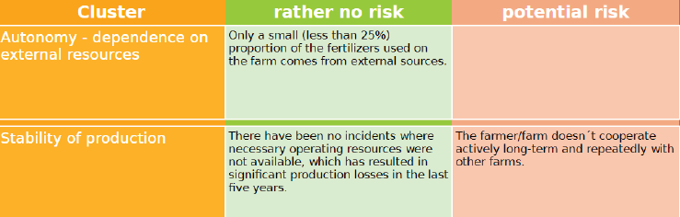
CAPTIVATE Eco-Farm Assessment & Decision Tool
CAP Transfer of Information Via Assessment, Training and Extension
Development process and final configuration
Results
Main data of the farm
Radar chart - showing the farm performance by eco-themes (SAFA sub-themes) in percentages, compared with the “ideal farm” (goal)
Good results above 70%, weaker results (“needs to be improved”) under 40%
List of subtheme goal achievement
Recommended good eco-practices and CAP measures, based on the results under the SAFA sub-themes, according to farm branches, and linked CAP measures.
List of indicators which are contributing the most to stronger and weaker results (making the more positive or negative impacts)
Risk assessment section

Slide 14
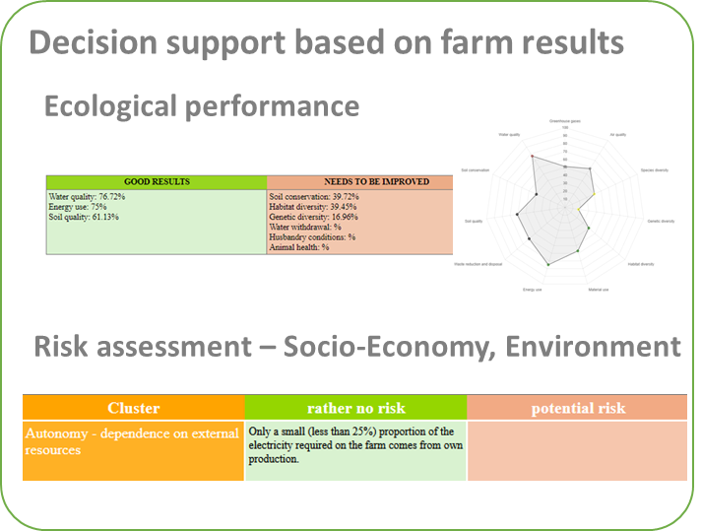
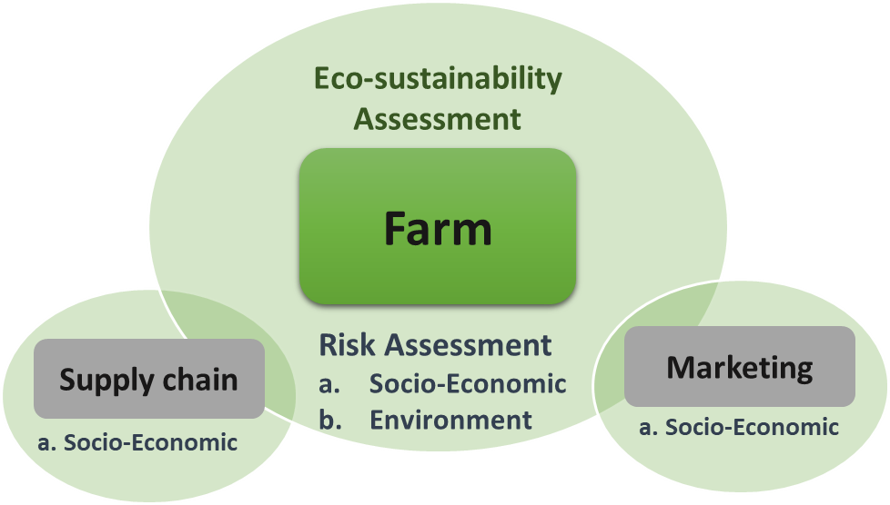
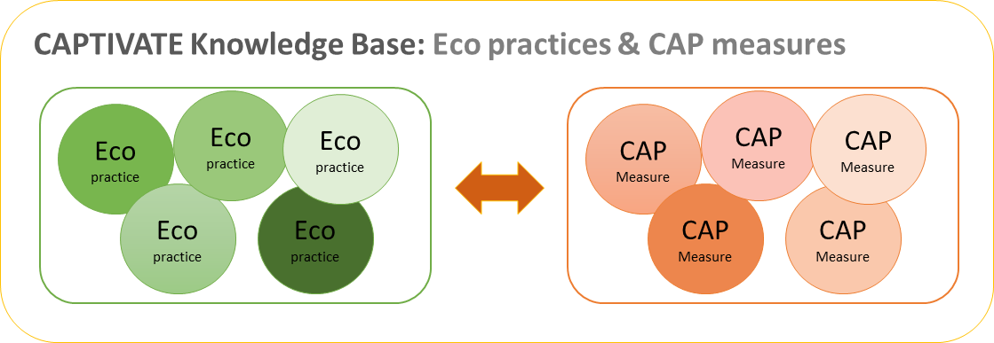
CAPTIVATE Eco-Farm Assessment & Decision Tool
CAP Transfer of Information Via Assessment, Training and Extension
EAD Tool
CAPTIVATE
Knowledge platform
Materials for capacity building:
- e-Learning Platform
- Glossary
- Farmers Handbook
- videos
- etc.
Assessment

Slide 15
CAPTIVATE Eco-Farm Assessment & Decision Tool
CAP Transfer of Information Via Assessment, Training and Extension
The Eco-Farm Assessment and Decision (EAD) Tool is
a digital self assessment approach for farmers and advisors to evaluate ecological sustainability at farm level,
comprising a set of sustainability indicators that attempt to provide information about the current status
and that can assist during farmer’s decision making process to identify suitable CAP Measures and Eco-practices.

