Slide 1

Conference
Main outputs of the CAPTIVATE project
Online 21.10.2024
CAPTIVATE CAP Transfer of Information Via Assessment, Training and Extension

Slide 2
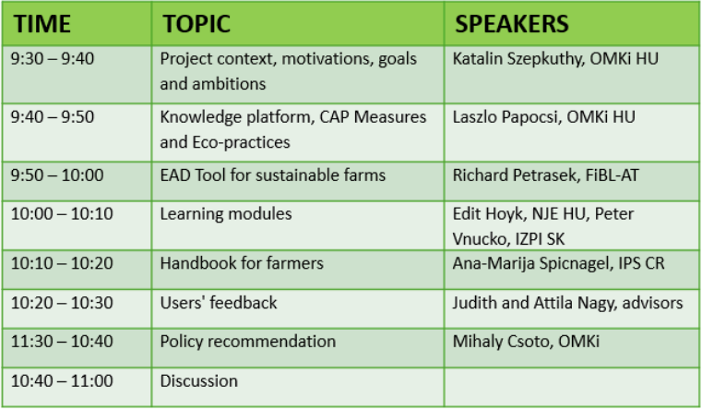
CAPTIVATE CAP Transfer of Information Via Assessment, Training and Extension
Conference 21.10.2024

Slide 3
CAPTIVATE CAP Transfer of Information Via Assessment, Training and Extension
Conference 21.10.2024
Discussion
  Do you have general questions about understanding the project, the individual presentations or the project results?
  How can the project results presented here or the interconnected, mutually complementary knowledge platform be used in your field and work environment?

Slide 4
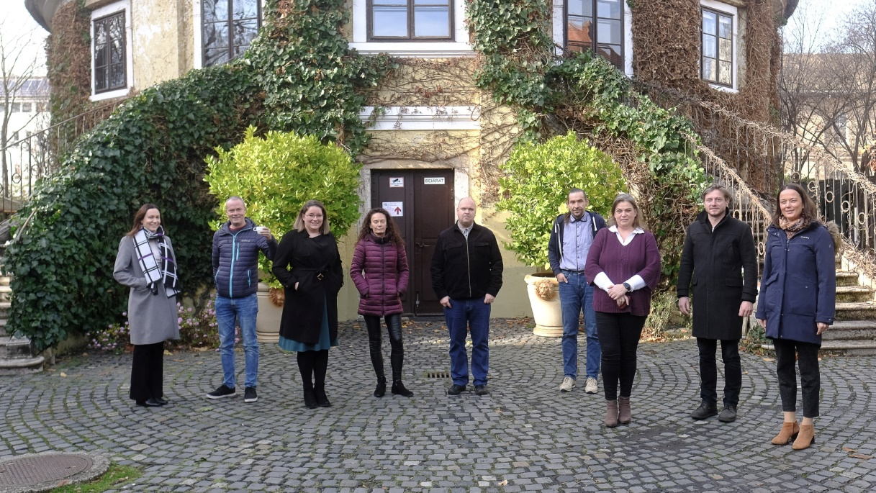
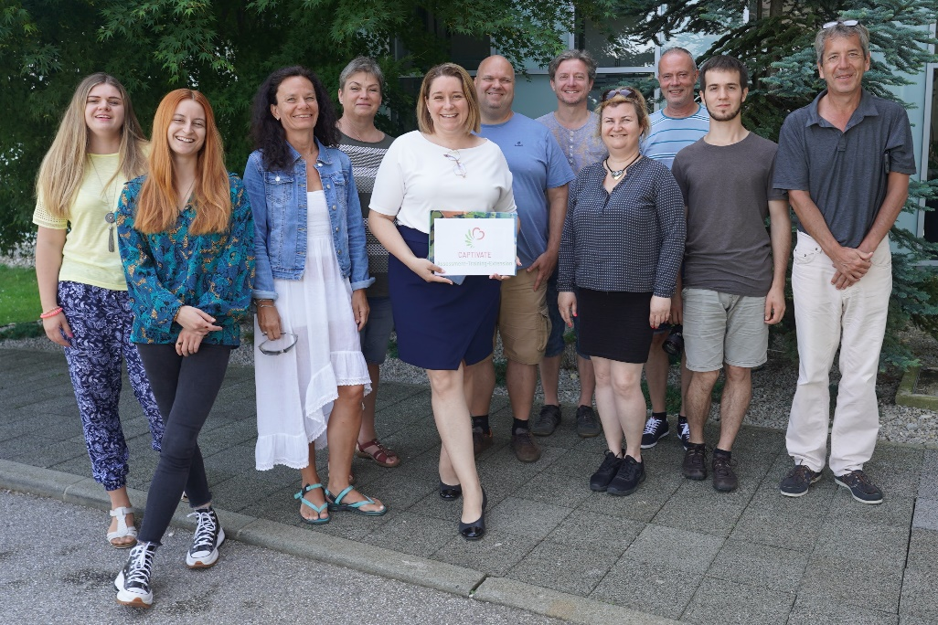
CAPTIVATE CAP Transfer of Information Via Assessment, Training and Extension
Conference 21.10.2024

